Slide 1


Module 2
Precinct Reorganization 101
Licensed by CC BY-NC-ND 4.0.

Slide 2
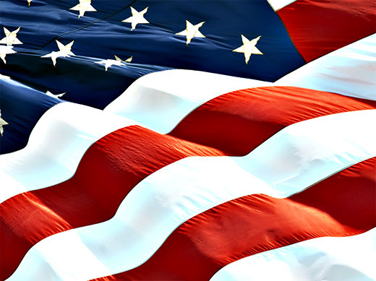
Many wonderful people in our South Carolina communities are looking at disturbing changes happening to our Republic. These grassroots citizens are realizing that each of us needs to get involved and make a difference.
Notes:
In Module 1, we talked about neighborhood patriots who are waking up to the reality that each of us needs to get involved, and that we CAN make a difference.

Slide 3
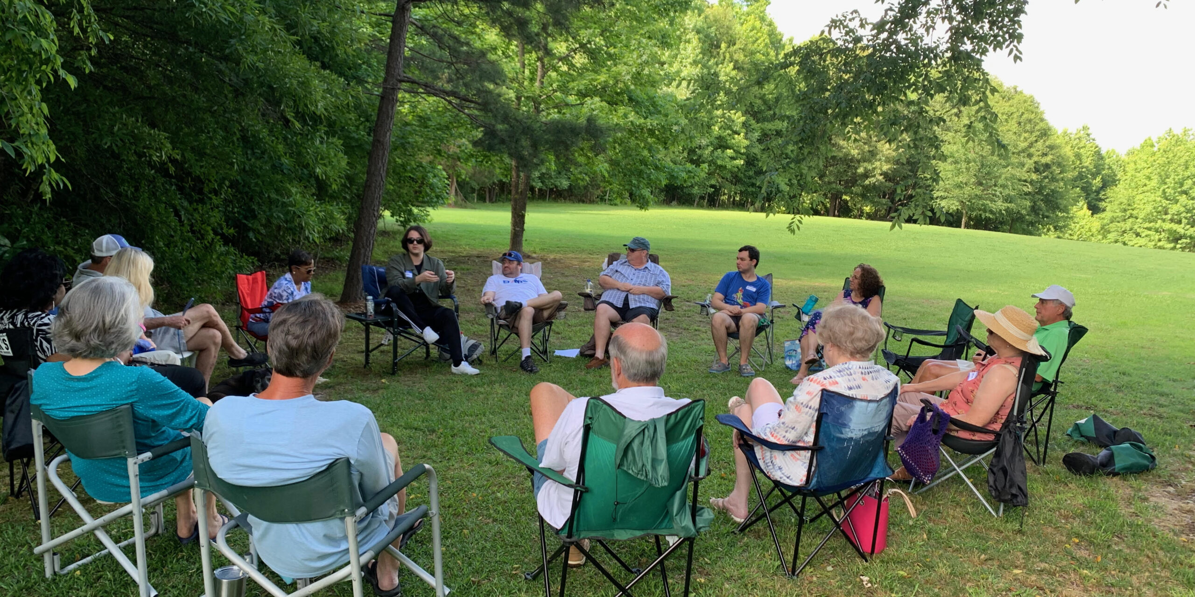
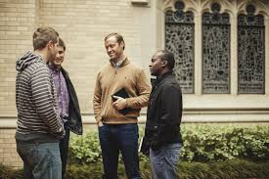

Building community.
Recruiting members.
Making a difference!
Notes:
That module described how we can build our neighborhoods, grow those communities of like-minded folks, and have fun doing it. It outlined the precinct organization, its officers, and some of the goals that can be accomplished.

Slide 4
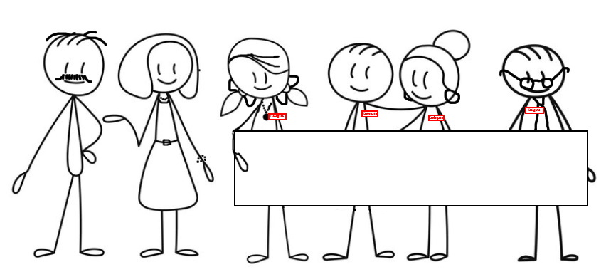
In our first module, we saw an example of a precinct whose members engaged and recruited others, then elected officers and delegates. Now let’s see HOW this happens…..
We are delegates to the county convention!
Notes:
We also saw an example of a precinct whose members pulled together, recruited others, and then elected folks to represent them.

Slide 5
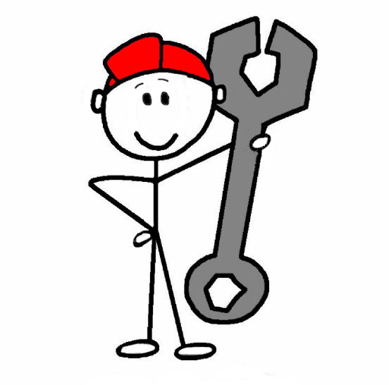
This module will show us the nuts and bolts of getting from “Point A” to “Point B” – from a community of precinct members to an organized precinct, with elected officers and delegates elected by you to be your representatives at the county convention.
Notes:
Module 2 will be like an instruction manual so that we can fully understand the nuts and bolts of the reorganization process. We’ll see how we organize and elect officers and delegates to represent us.

Slide 6

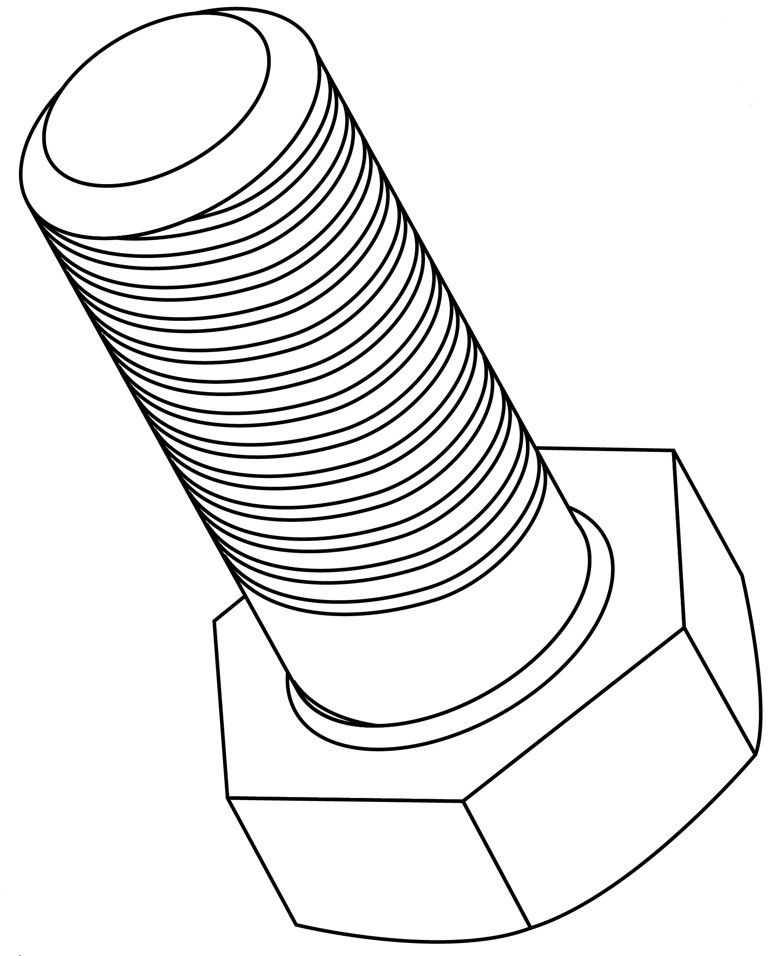
All 46 counties in South Carolina hold their reorganization meetings in March, and this is done every two years.
SC CODE OF LAW
Notes:
The SC Code establishes the schedule, and each political party is required to hold reorganization meetings every two years. This is when the people in all of the different precincts will meet and elect officers and delegates. The next reorg is just a few months away, in March of 2025.

Slide 7
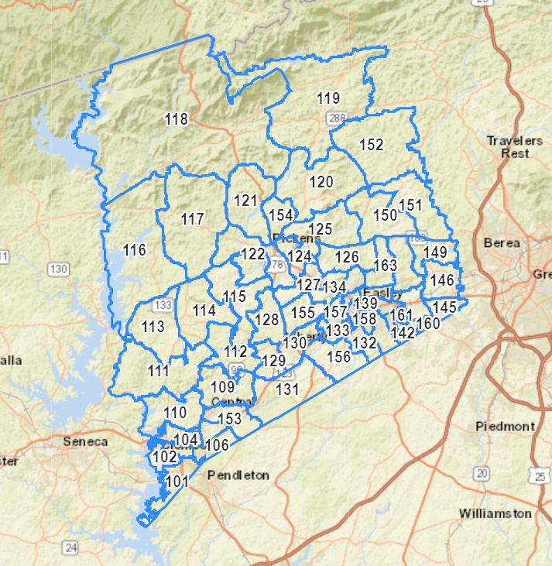

Some counties plan their reorganization in one fairly centralized location and all the precincts gather there.
Notes:
Some counties plan their reorganization in one centralized location and all the precincts gather there

Slide 8
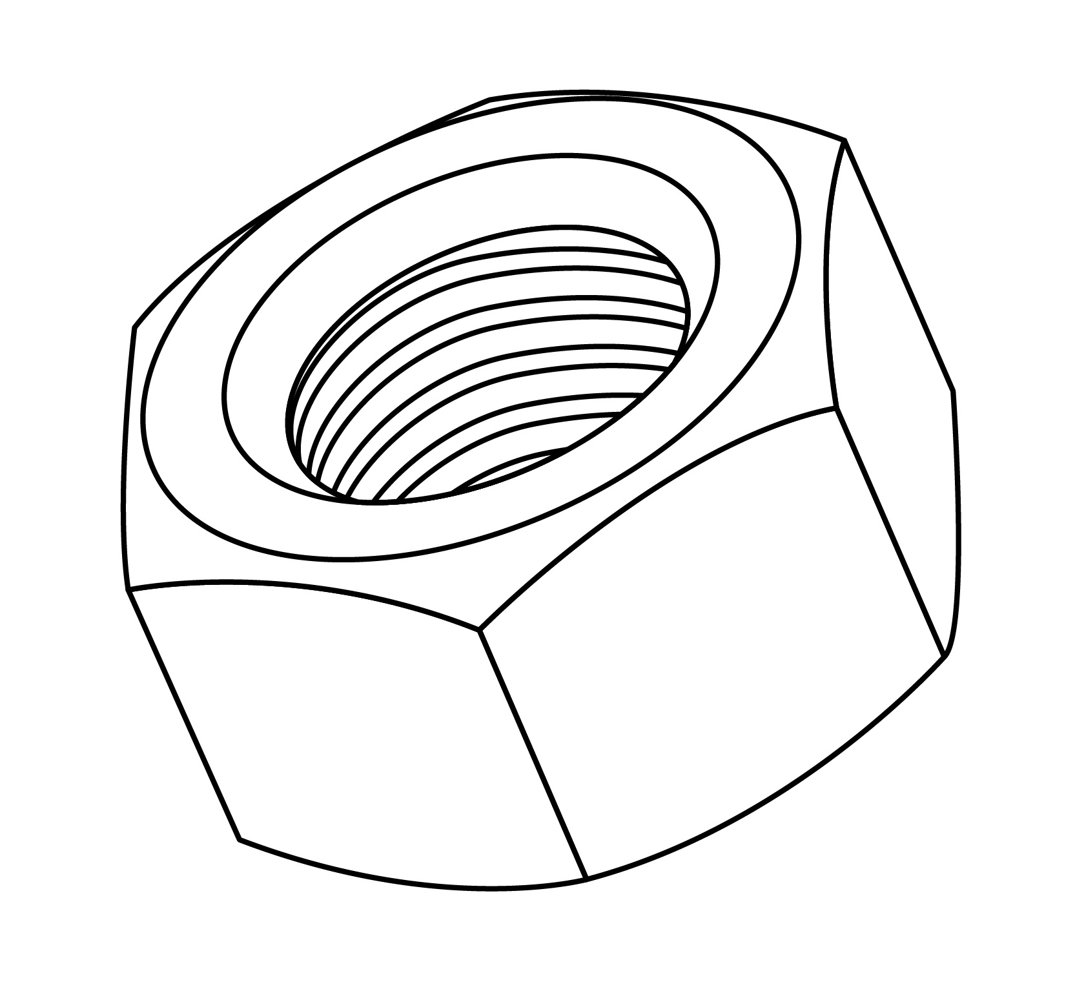
Some counties plan meetings in each precinct.
Notes:
Some counties plan reorganization meetings in each precinct.

Slide 9
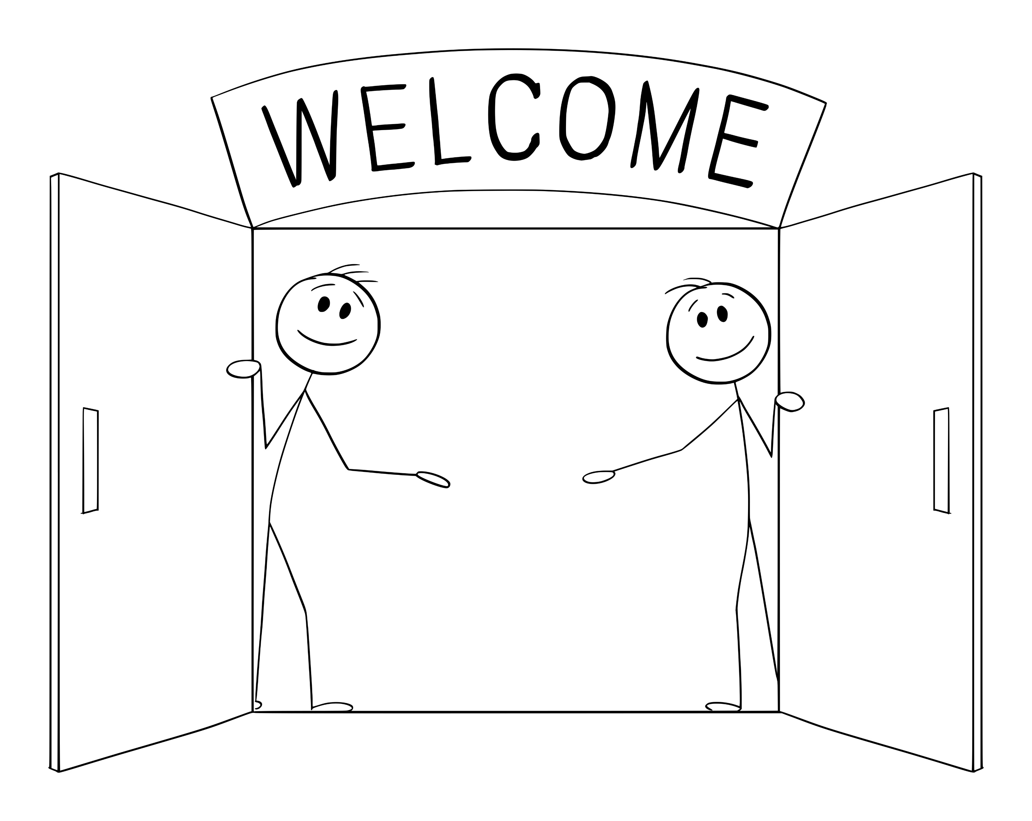
Whether in one location or many, it’s vitally important to have as many like-minded people as possible to attend. It should be announced on social media or news and radio.
Notes:
You might have to search high and low, but let’s say that you found the announced location, date, and time for reorg in your county. Gather your neighbors together (you HAVE been having informal get togethers, right? Building community? Of course you have!)

Slide 10

Check in, or “credentialing,” is usually quick and easy; you just need a photo ID like when you vote. It’s good to scan the announcement to see if you need to bring anything else.
ID
Notes:
After you show your photo ID, you will join other precinct members at a table or perhaps just a group of chairs in a large room. It gets noisy sometimes, but that’s great – that means a lot of grassroots folks are excited about participating!

Slide 11
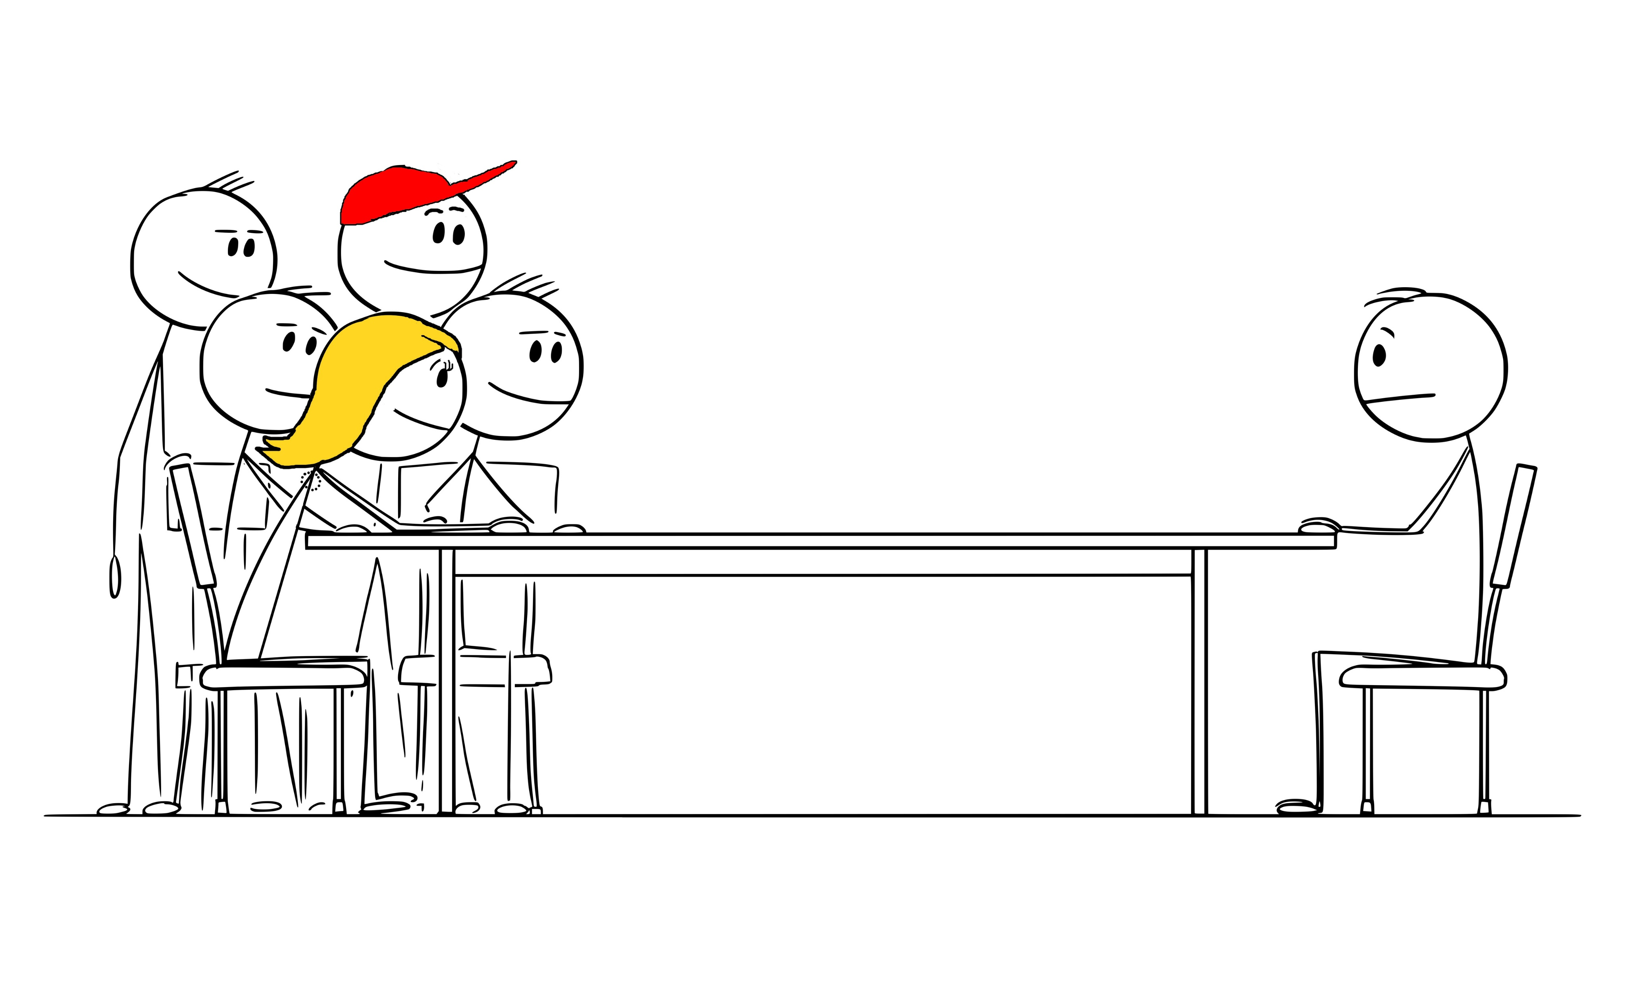
In many counties across South Carolina, there are precincts where only one or two people have come to reorg in the past.
Notes:
Sometimes your precinct group will be quite surprising to the other folks you meet there. They might not be expecting anyone except the one or two who have attended in the past!

Slide 12
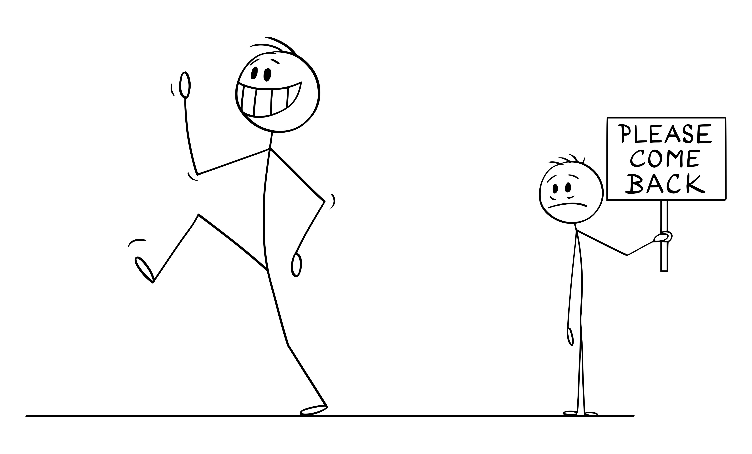
Many of these folks have been attending for decades. They participate at reorg and then don’t come back for two years!
That’s very frustrating for “we the people” who really want to be involved . . .and want positive change.
Notes:
Many long-time attendees think of reorg as a “once every two years” event. They leave, waving at each other, “See you in two years!” But our organized precincts need to be so much more than a biennial gathering!

Slide 13
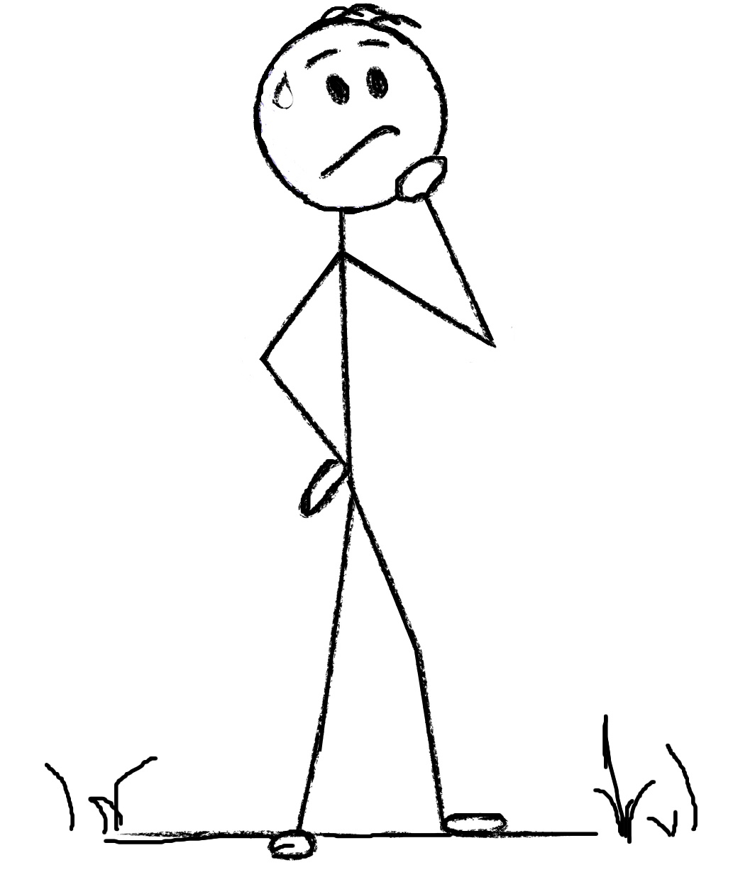
You see, some of them are truly puzzled as to why America First folks want to be involved and get to work making changes!
Notes:
Some of the long-time attendees are truly puzzled as to why America First folks want to get involved . . . A few of them enjoy the small sense of power that they feel, as head of a precinct. Some have no problems with continuing as things are, because quite frankly, it’s easier to sit back and let the “professionals” in Columbia handle things.

Slide 14
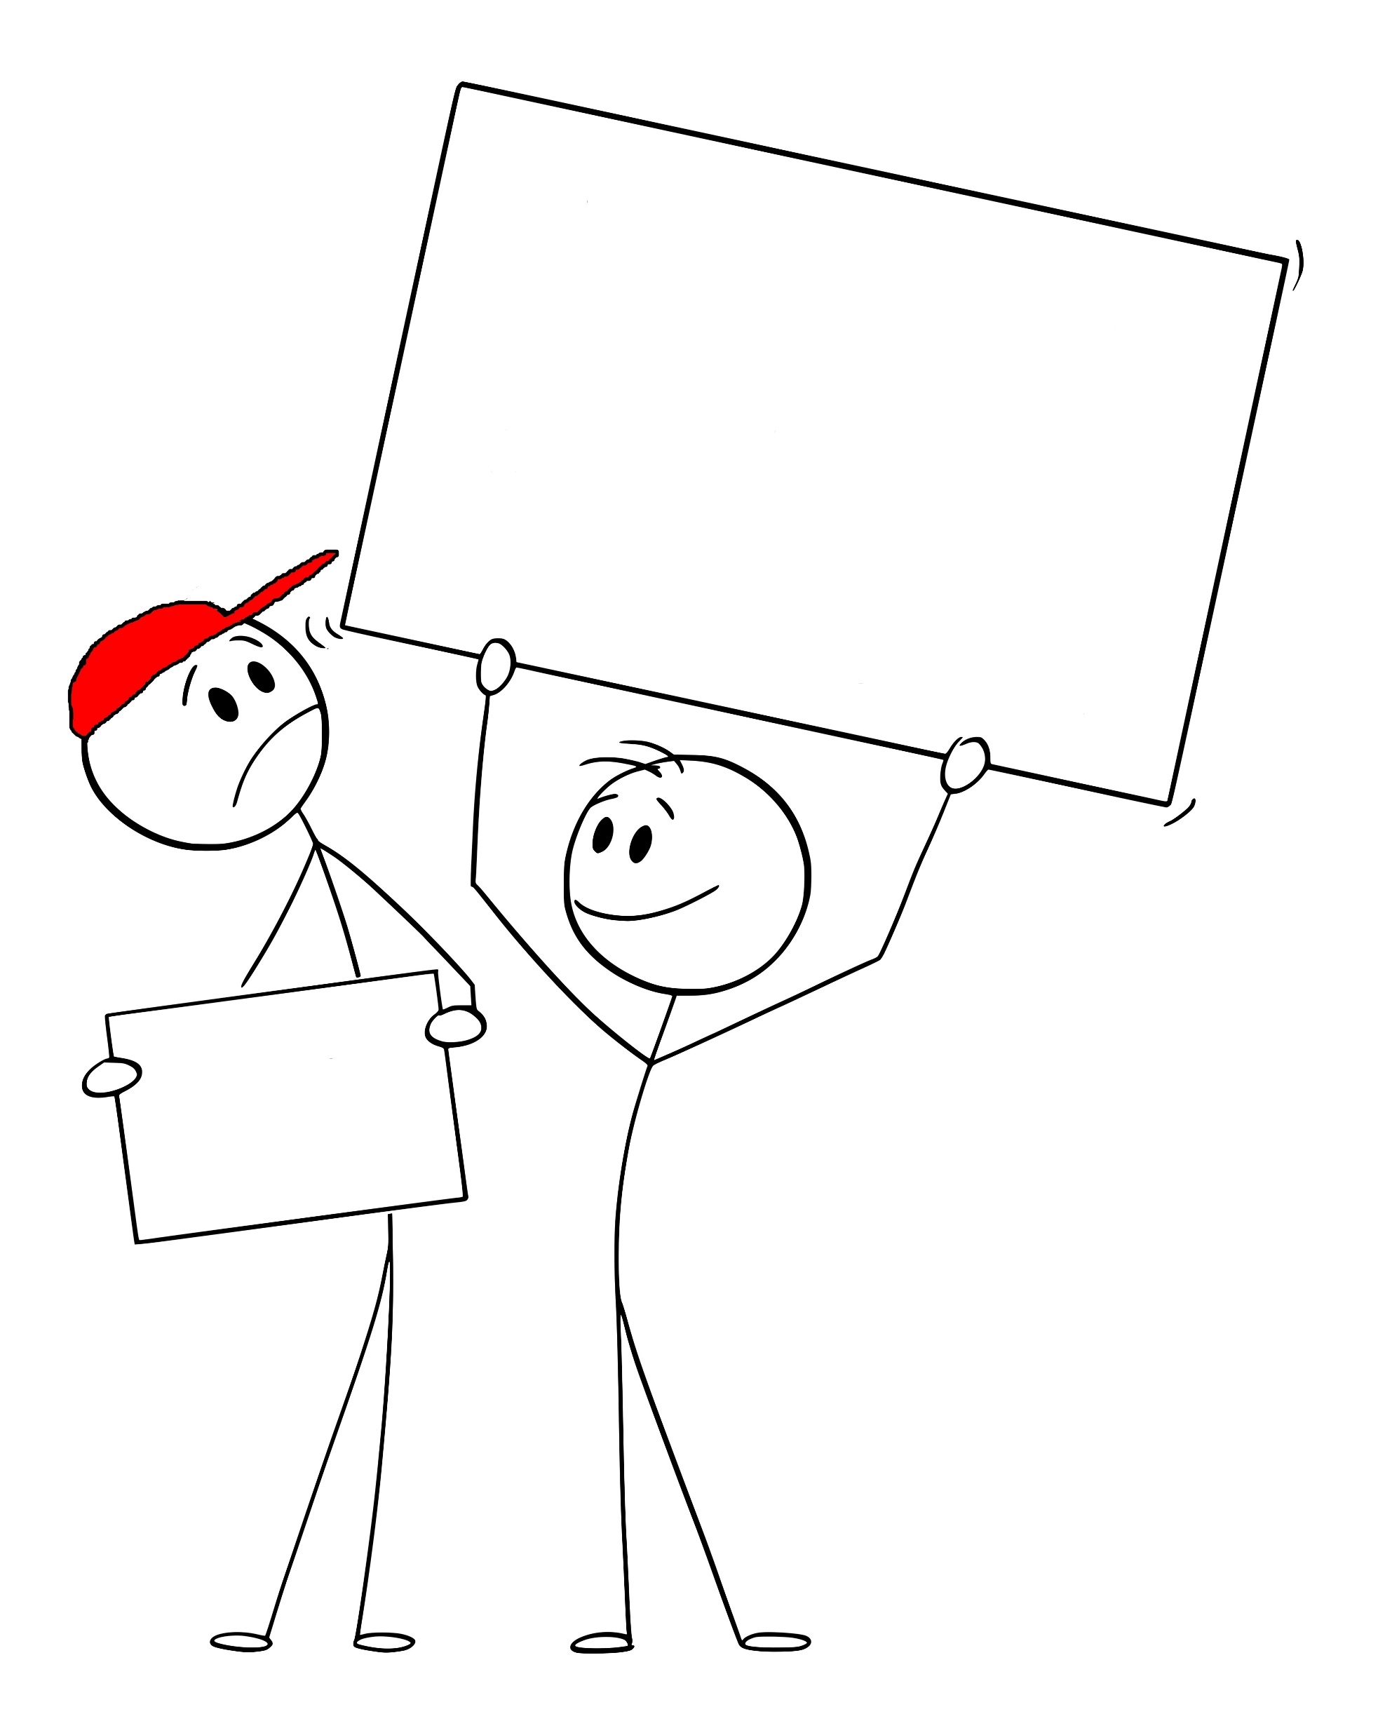
This is why they don’t understand why the grassroots folks want to change things.
After all, they “have been doing things this way for as long as they can remember.”
Same Ol’ Thing
Precinct Growth
Notes:
But doing things the same way for decades has resulted in South Carolina having the most liberal legislature in any “red” state, and a state party that exerts pressure from the top down. This is why it’s so important to have an active, growing precinct and bring your neighbors with you to reorg.

Slide 15
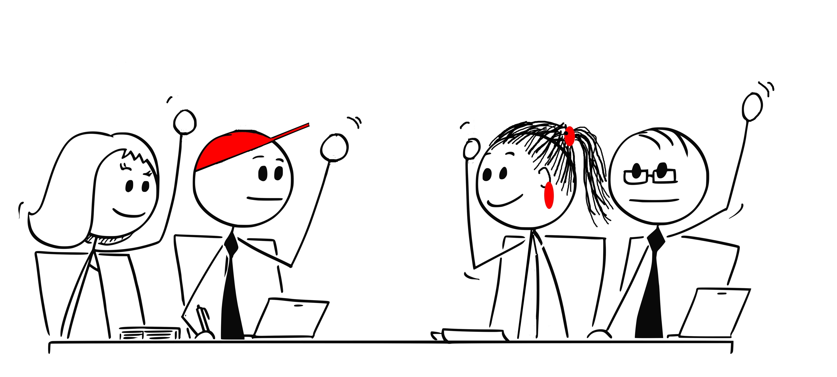
Some of them are America First and have just been waiting for the cavalry to arrive.
They welcome the change and are ready to engage, vote, and speak out.
Notes:
There will be a few who will welcome you and your precinct neighbors, because they have been hoping for the cavalry to arrive! They’re ready to engage and vote and make a difference.

Slide 16
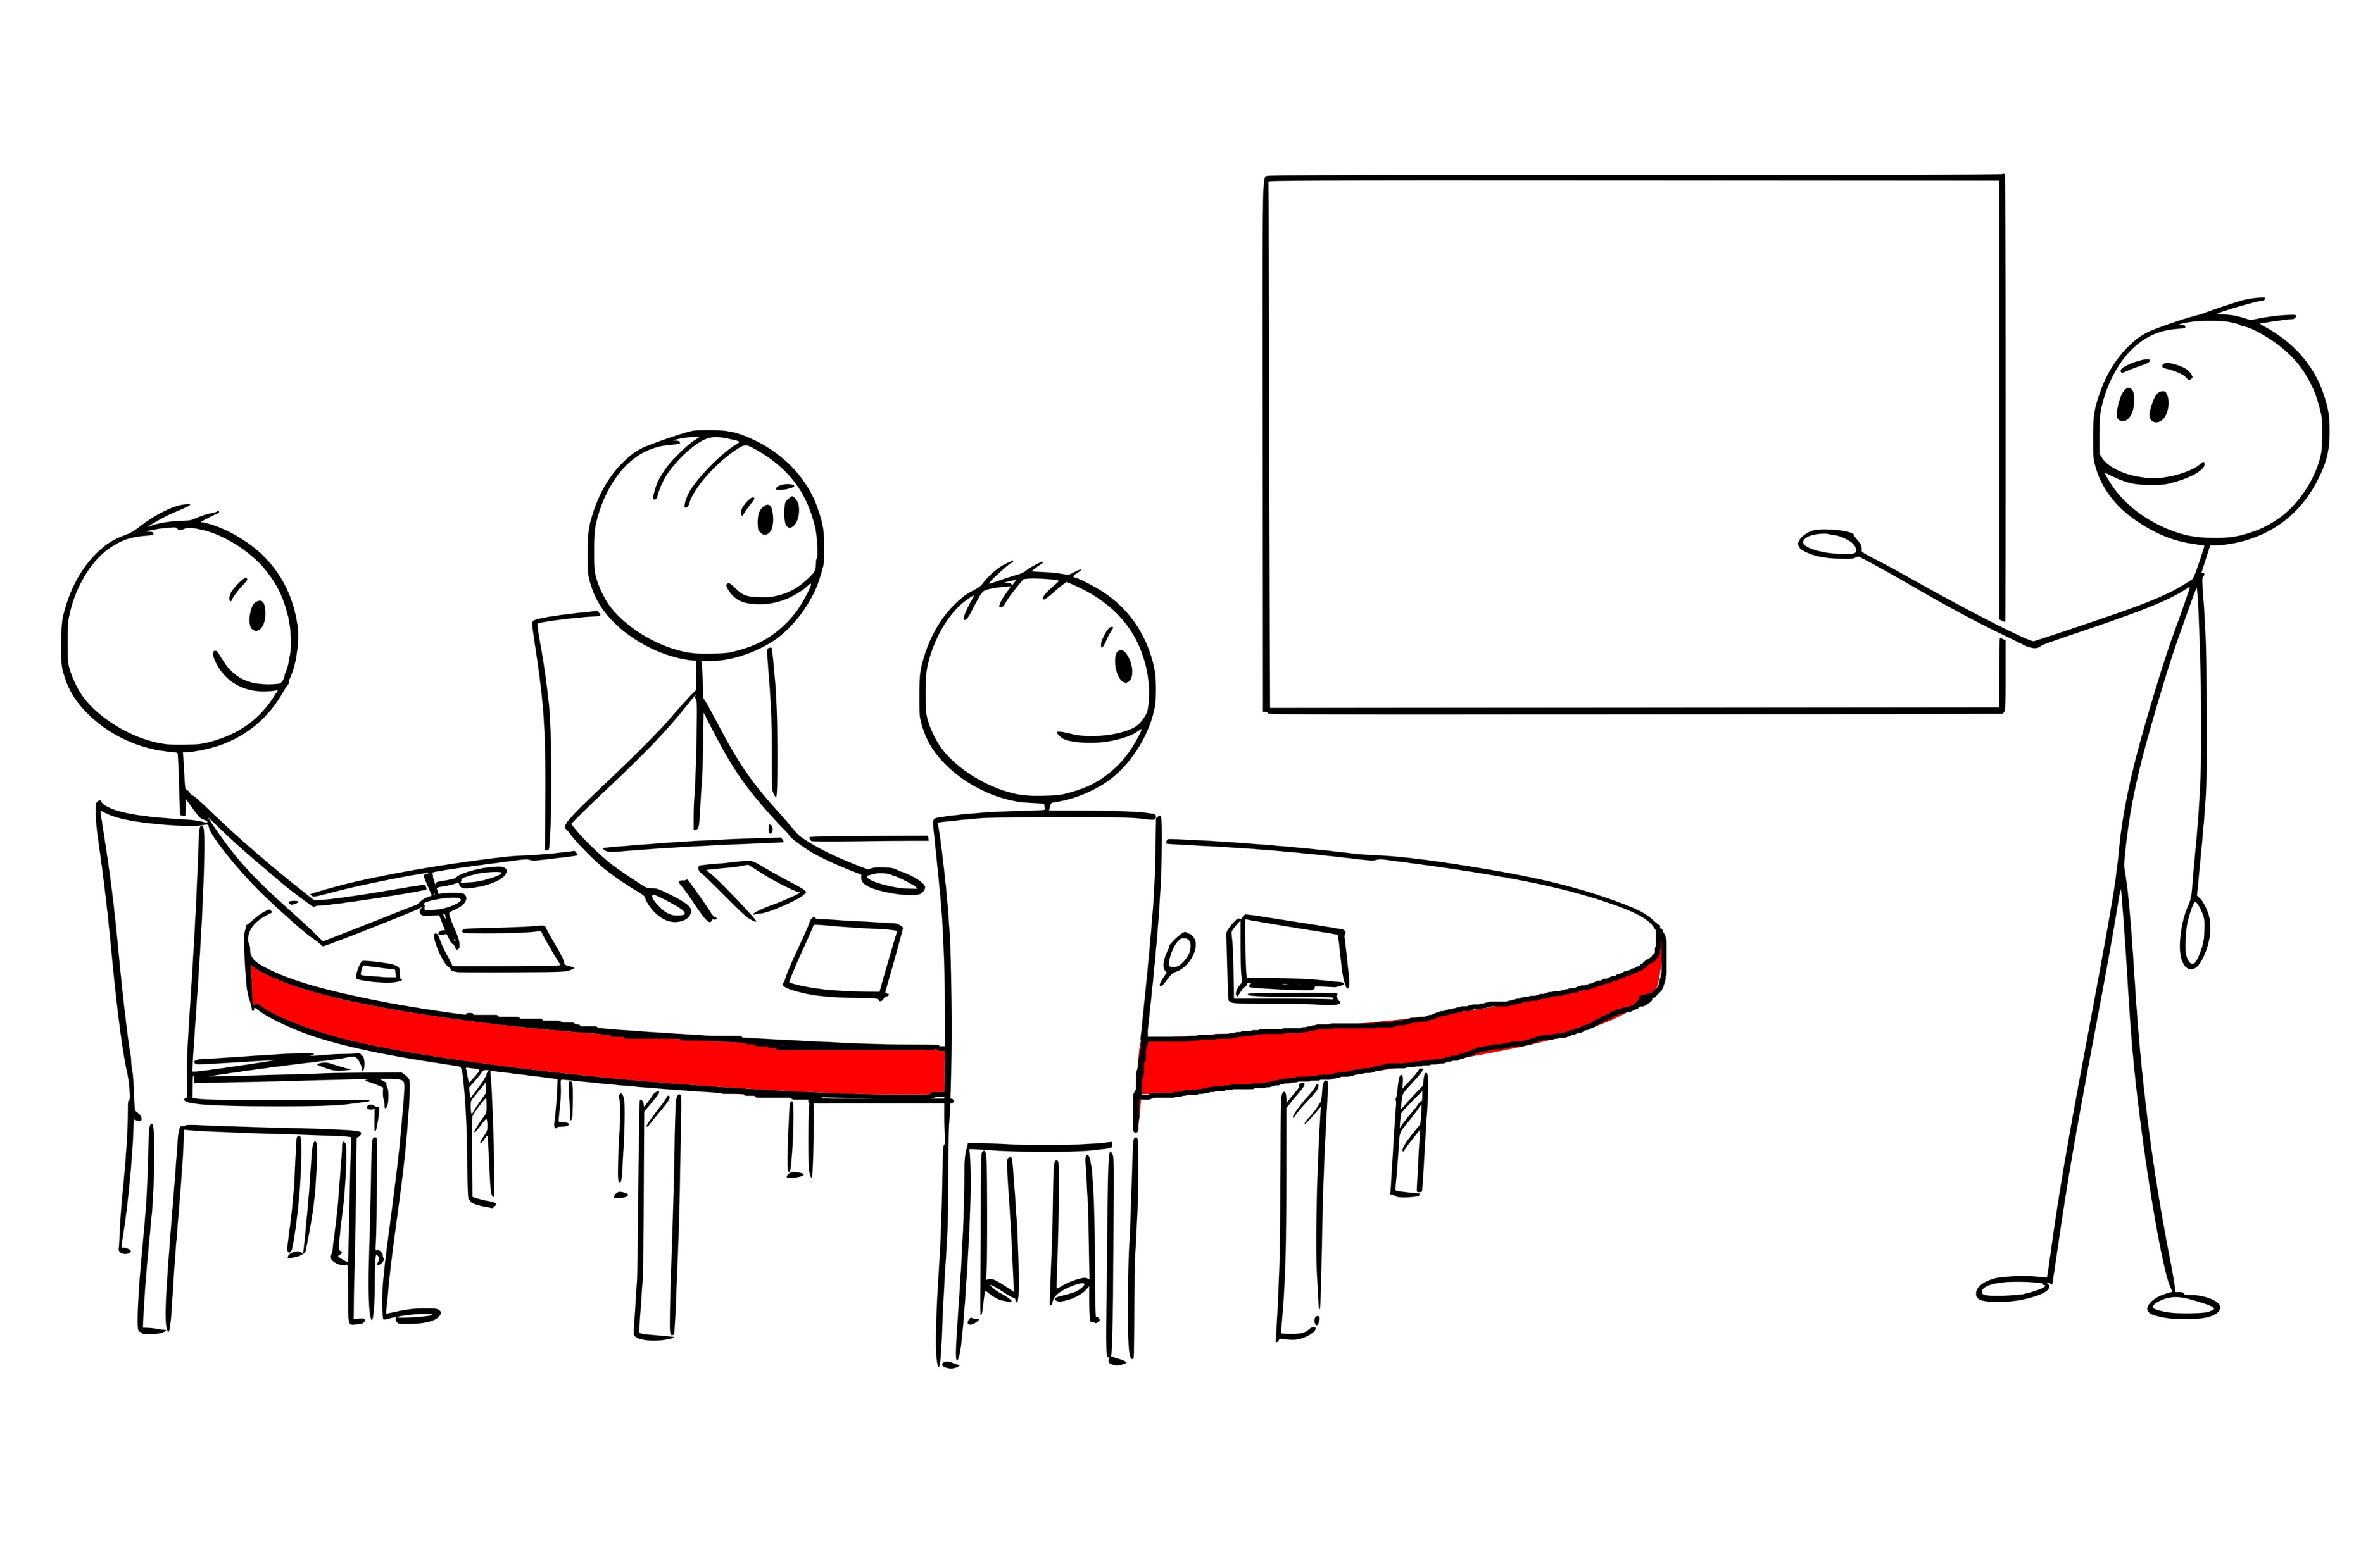
Our Precinct Goals
You will be able to welcome them, introduce them to your group of precinct members, and outline your goals.
Notes:
Because you have built community in your precinct, you already know who is MAGA, and who is interested in serving as leaders. This is another reason why it’s so important to bring a large group of like-minded members with you – you should be able to vote your preferred officers into leadership.

Slide 17
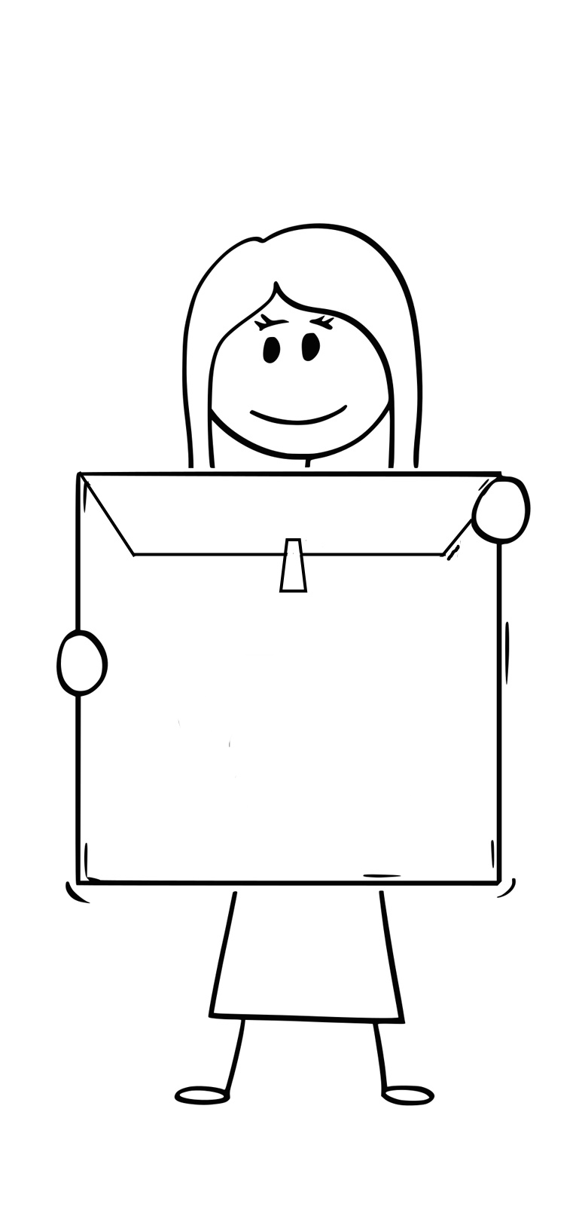
The state GOP will supply counties with packets prepared for each precinct; others will simply hand out some instructions and forms. Let’s say your precinct is ready, and let’s open the envelope!
Notes:
There will be a packet of materials for each precinct. Here’s what happens when you open that up. First of all, look for instructions and review them, so that your precinct follows procedures correctly.

Slide 18
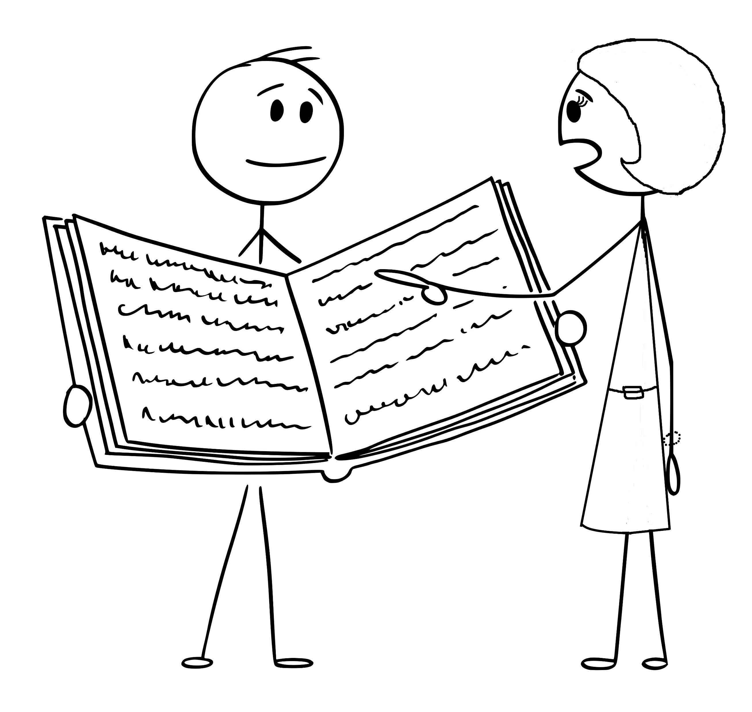
You and your neighbors need to follow instructions for the meeting. Many begin with prayer and the pledge to the American flag, if one is available.
Then, you are ready to nominate and vote on officers one at a time.
President, vice president, secretary, and committeeperson.
Notes:
Don’t worry about making mistakes. You’ll be nominating the neighbors you have met in your community meetings and voting for them one at a time. There’s usually a sheet of Roberts Rules in the packet, but if not, informal language is fine. (They’ll take office after the county convention in April.) If you don’t have enough people to fill each role, it’s ok for one person to take more than one office.

Slide 19
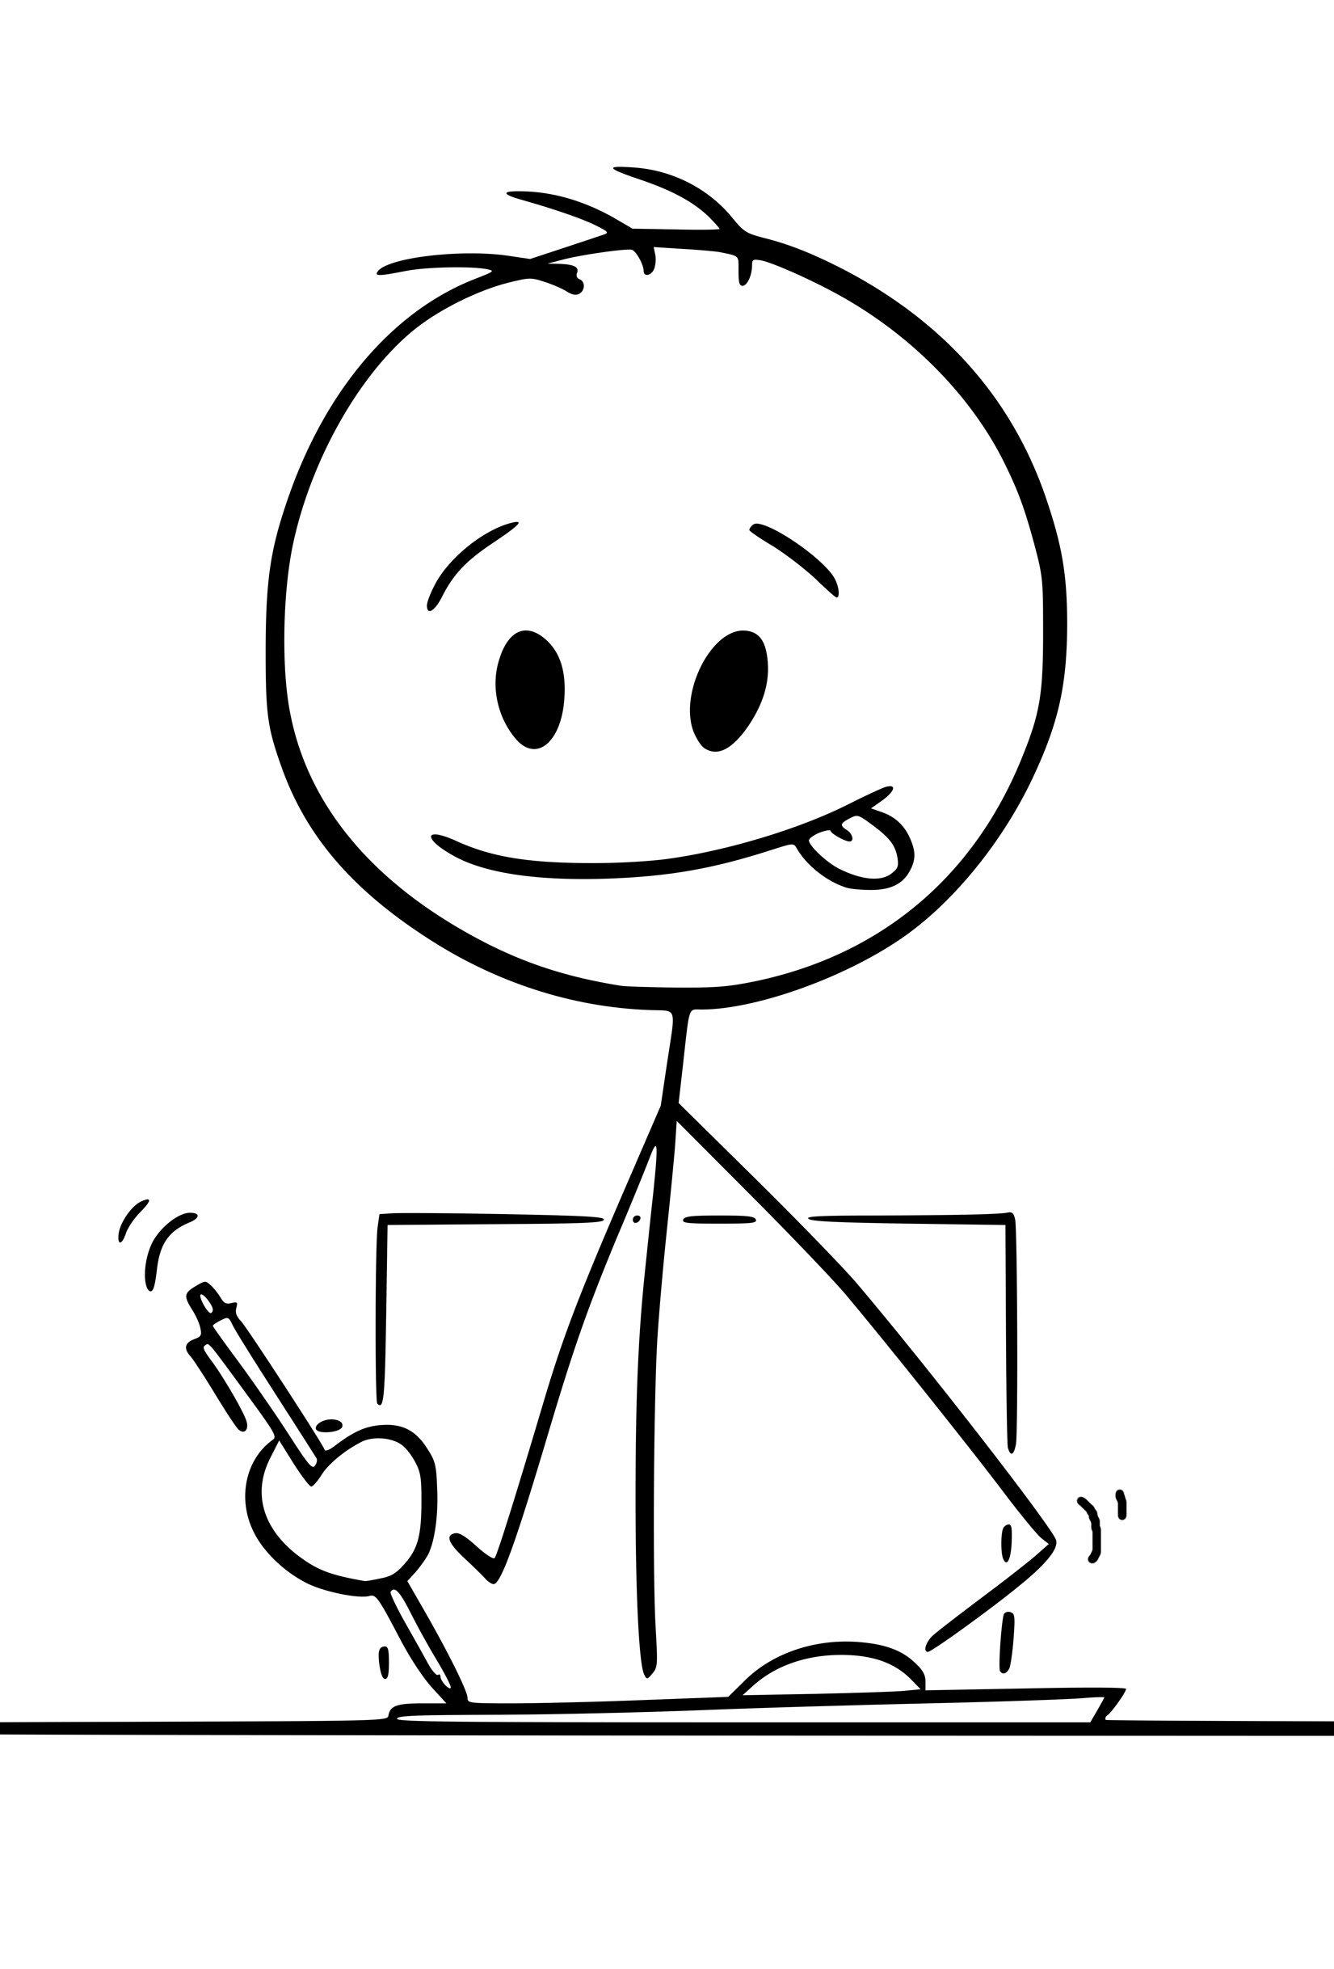

Elect delegates and alternates to participate in the upcoming county convention.
Fill out the precinct forms and hand them to the county party secretary.
Notes:
Remember, the committeeperson is the neighbor you have chosen to attend the county meetings, represent you, and report to the precinct. There will be a number on or in your envelope that tells you how many delegates you can send to convention. Let’s say you can have seven delegates – vote first for delegates, and then you can also elect seven alternates in case they can’t attend.

Slide 20
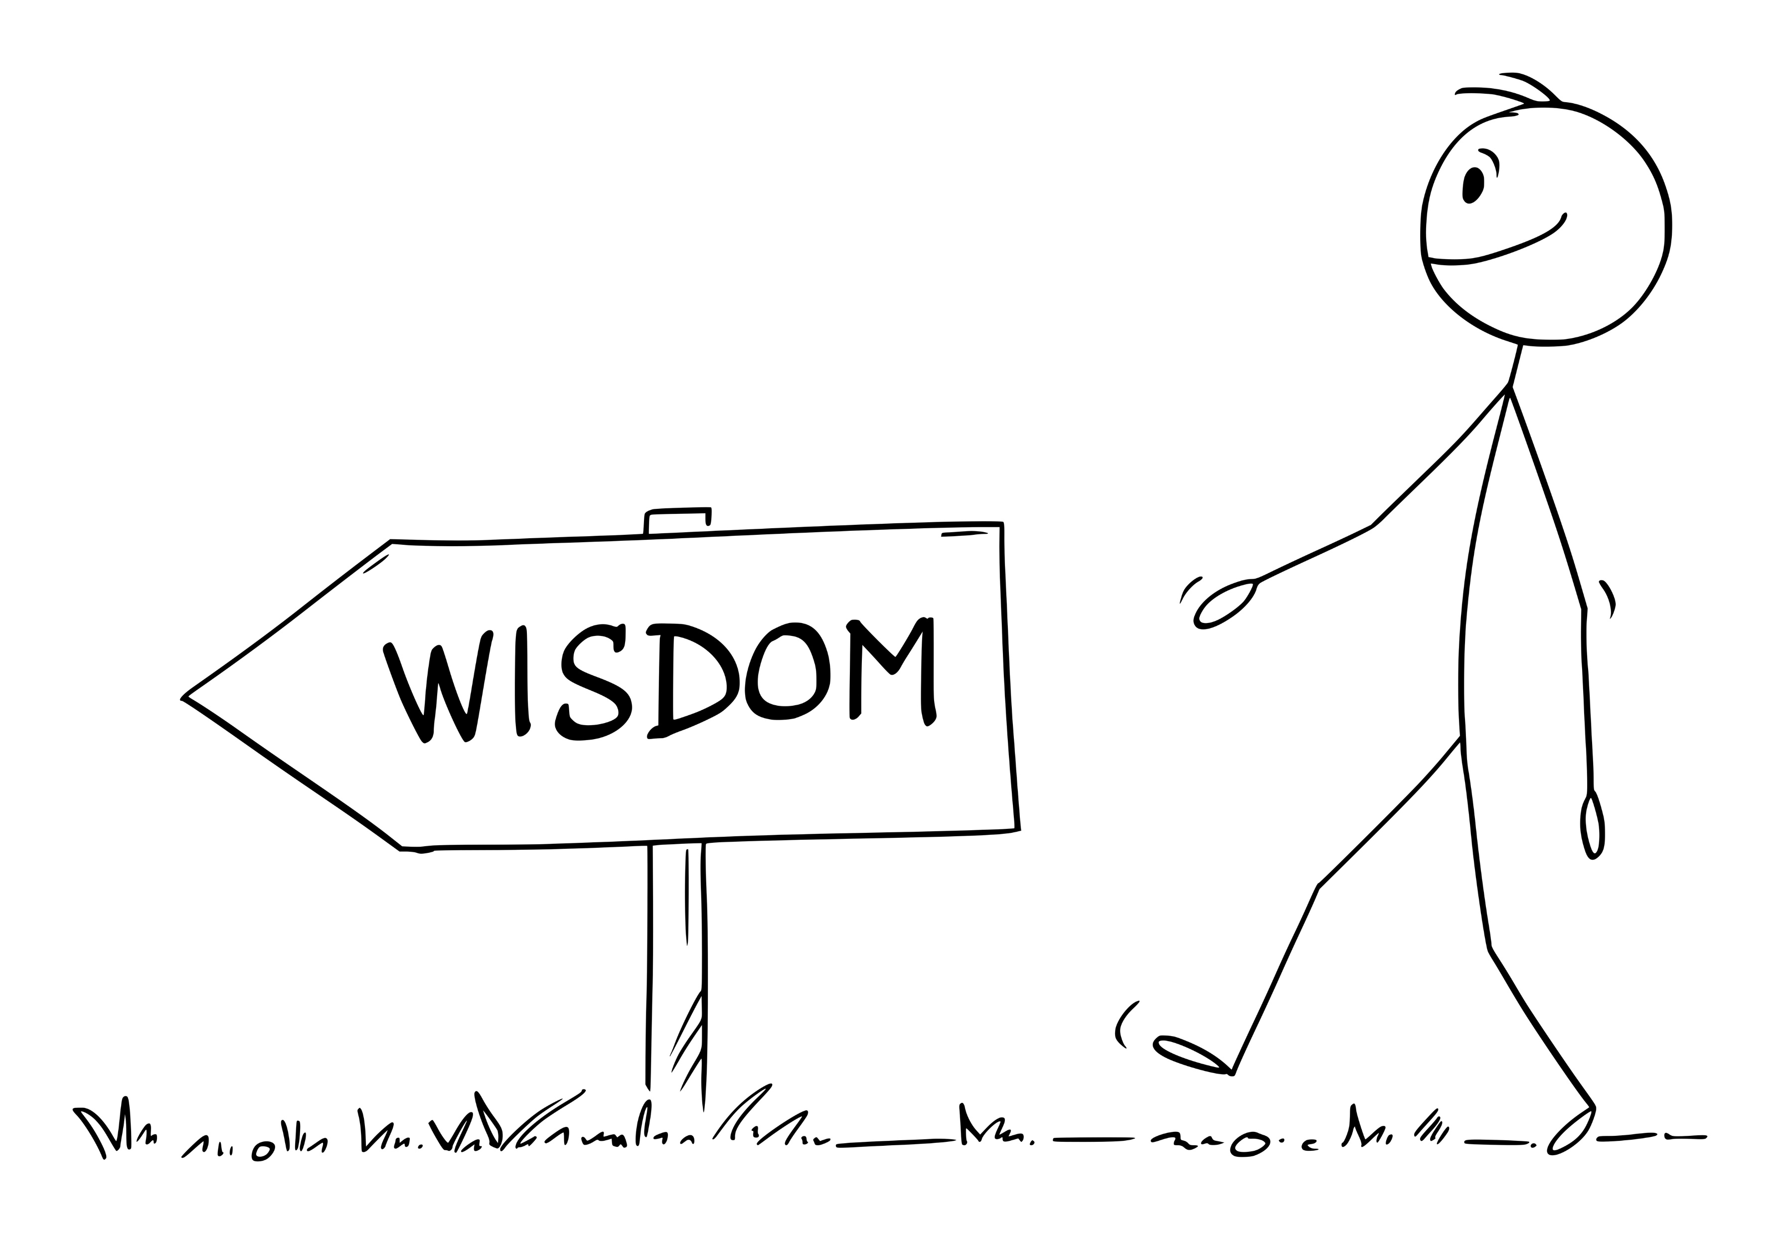
County convention is next!
Your delegates and alternates participate in April, representing your precinct.
County Convention
Notes:
You’ll be “credentialed” at the county convention much like you were at the precinct reorg: this time, you’ll check in, have an opportunity to listen to speakers, and vote.

Slide 21
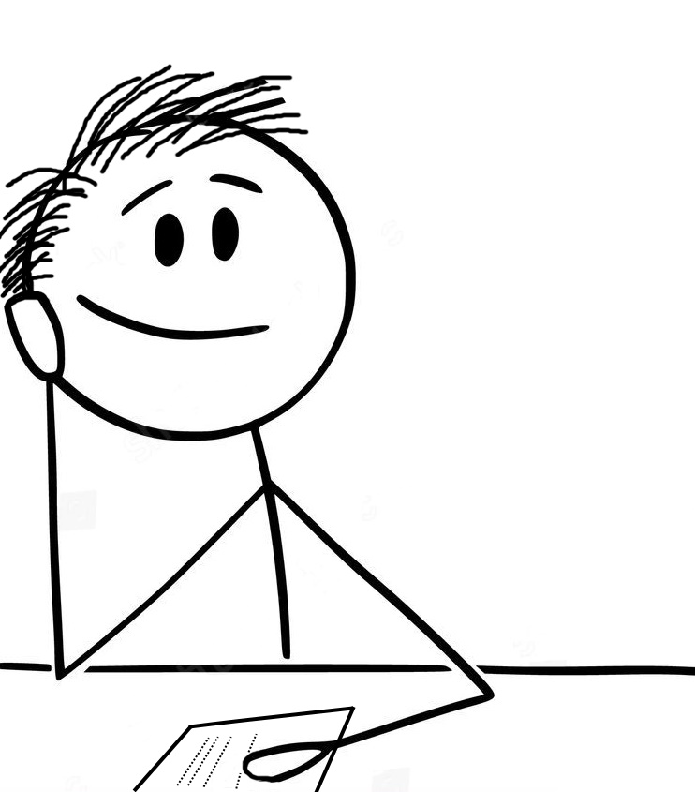
All of the delegates at convention will vote for a county chairperson, vice chairpersons, and a state committeeperson to participate and vote in Columbia meetings.
Notes:
Remember, this is representative government in action! This is as good a time as any to remind ourselves that the more America First committeepersons we counties send to Columbia, the more effective we can all be in making a difference at the state level. In order to make change, we need a majority of the 46 counties to send committeepersons and chairpersons who believe in the “from the bottom to the top” direction of party leadership.

Slide 22
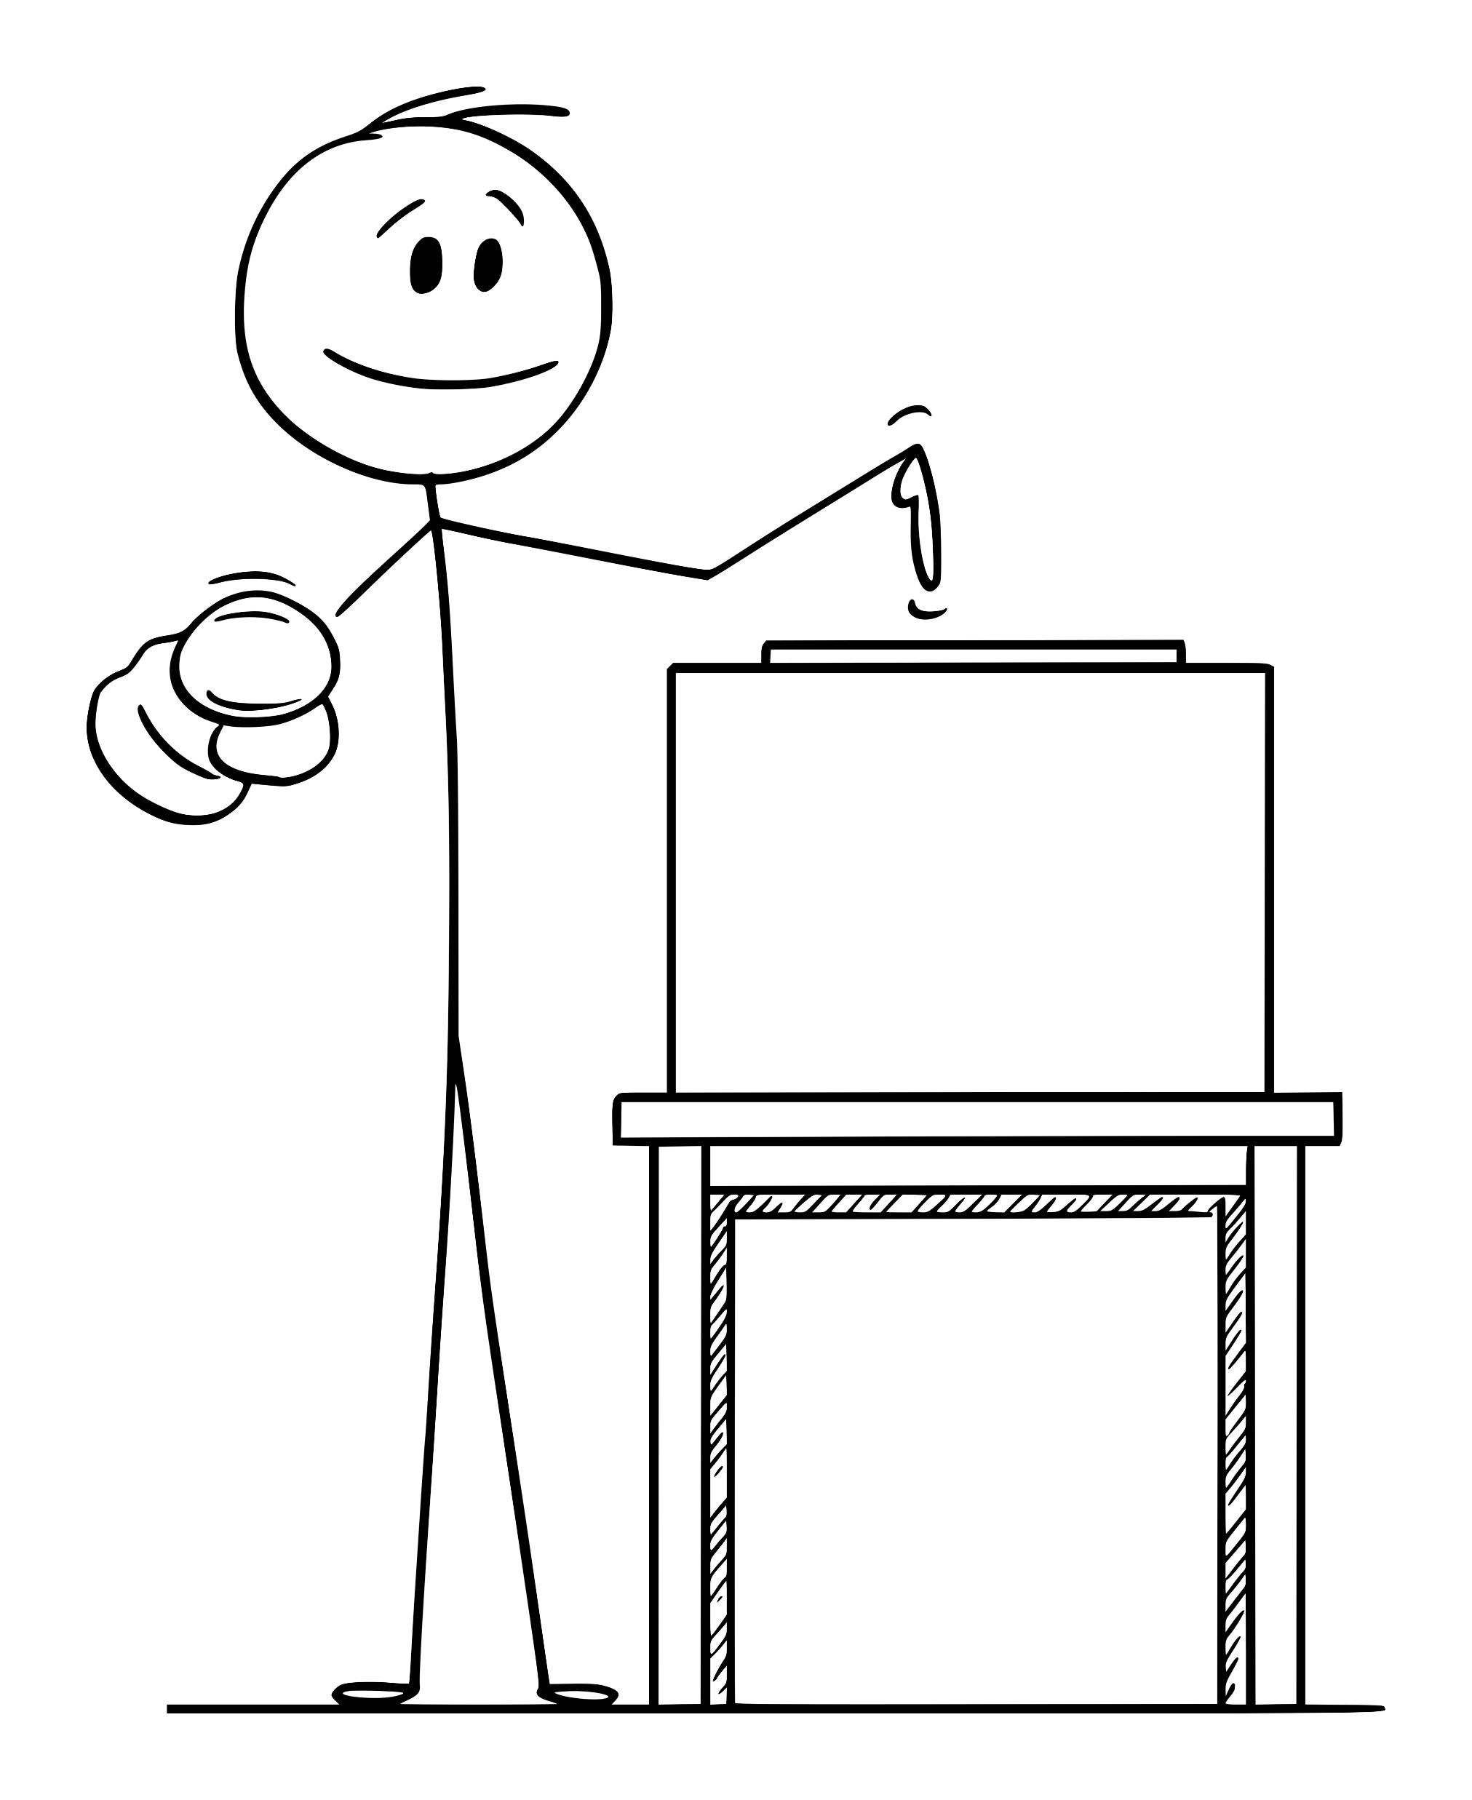
It’s also vitally important to vote for delegates and alternates to represent you at the upcoming state convention in May.
Notes:
One of the most important tasks at the county convention is to mark your ballot, voting for delegates to the state convention. It’s important to send folks who will represent your views.

Slide 23
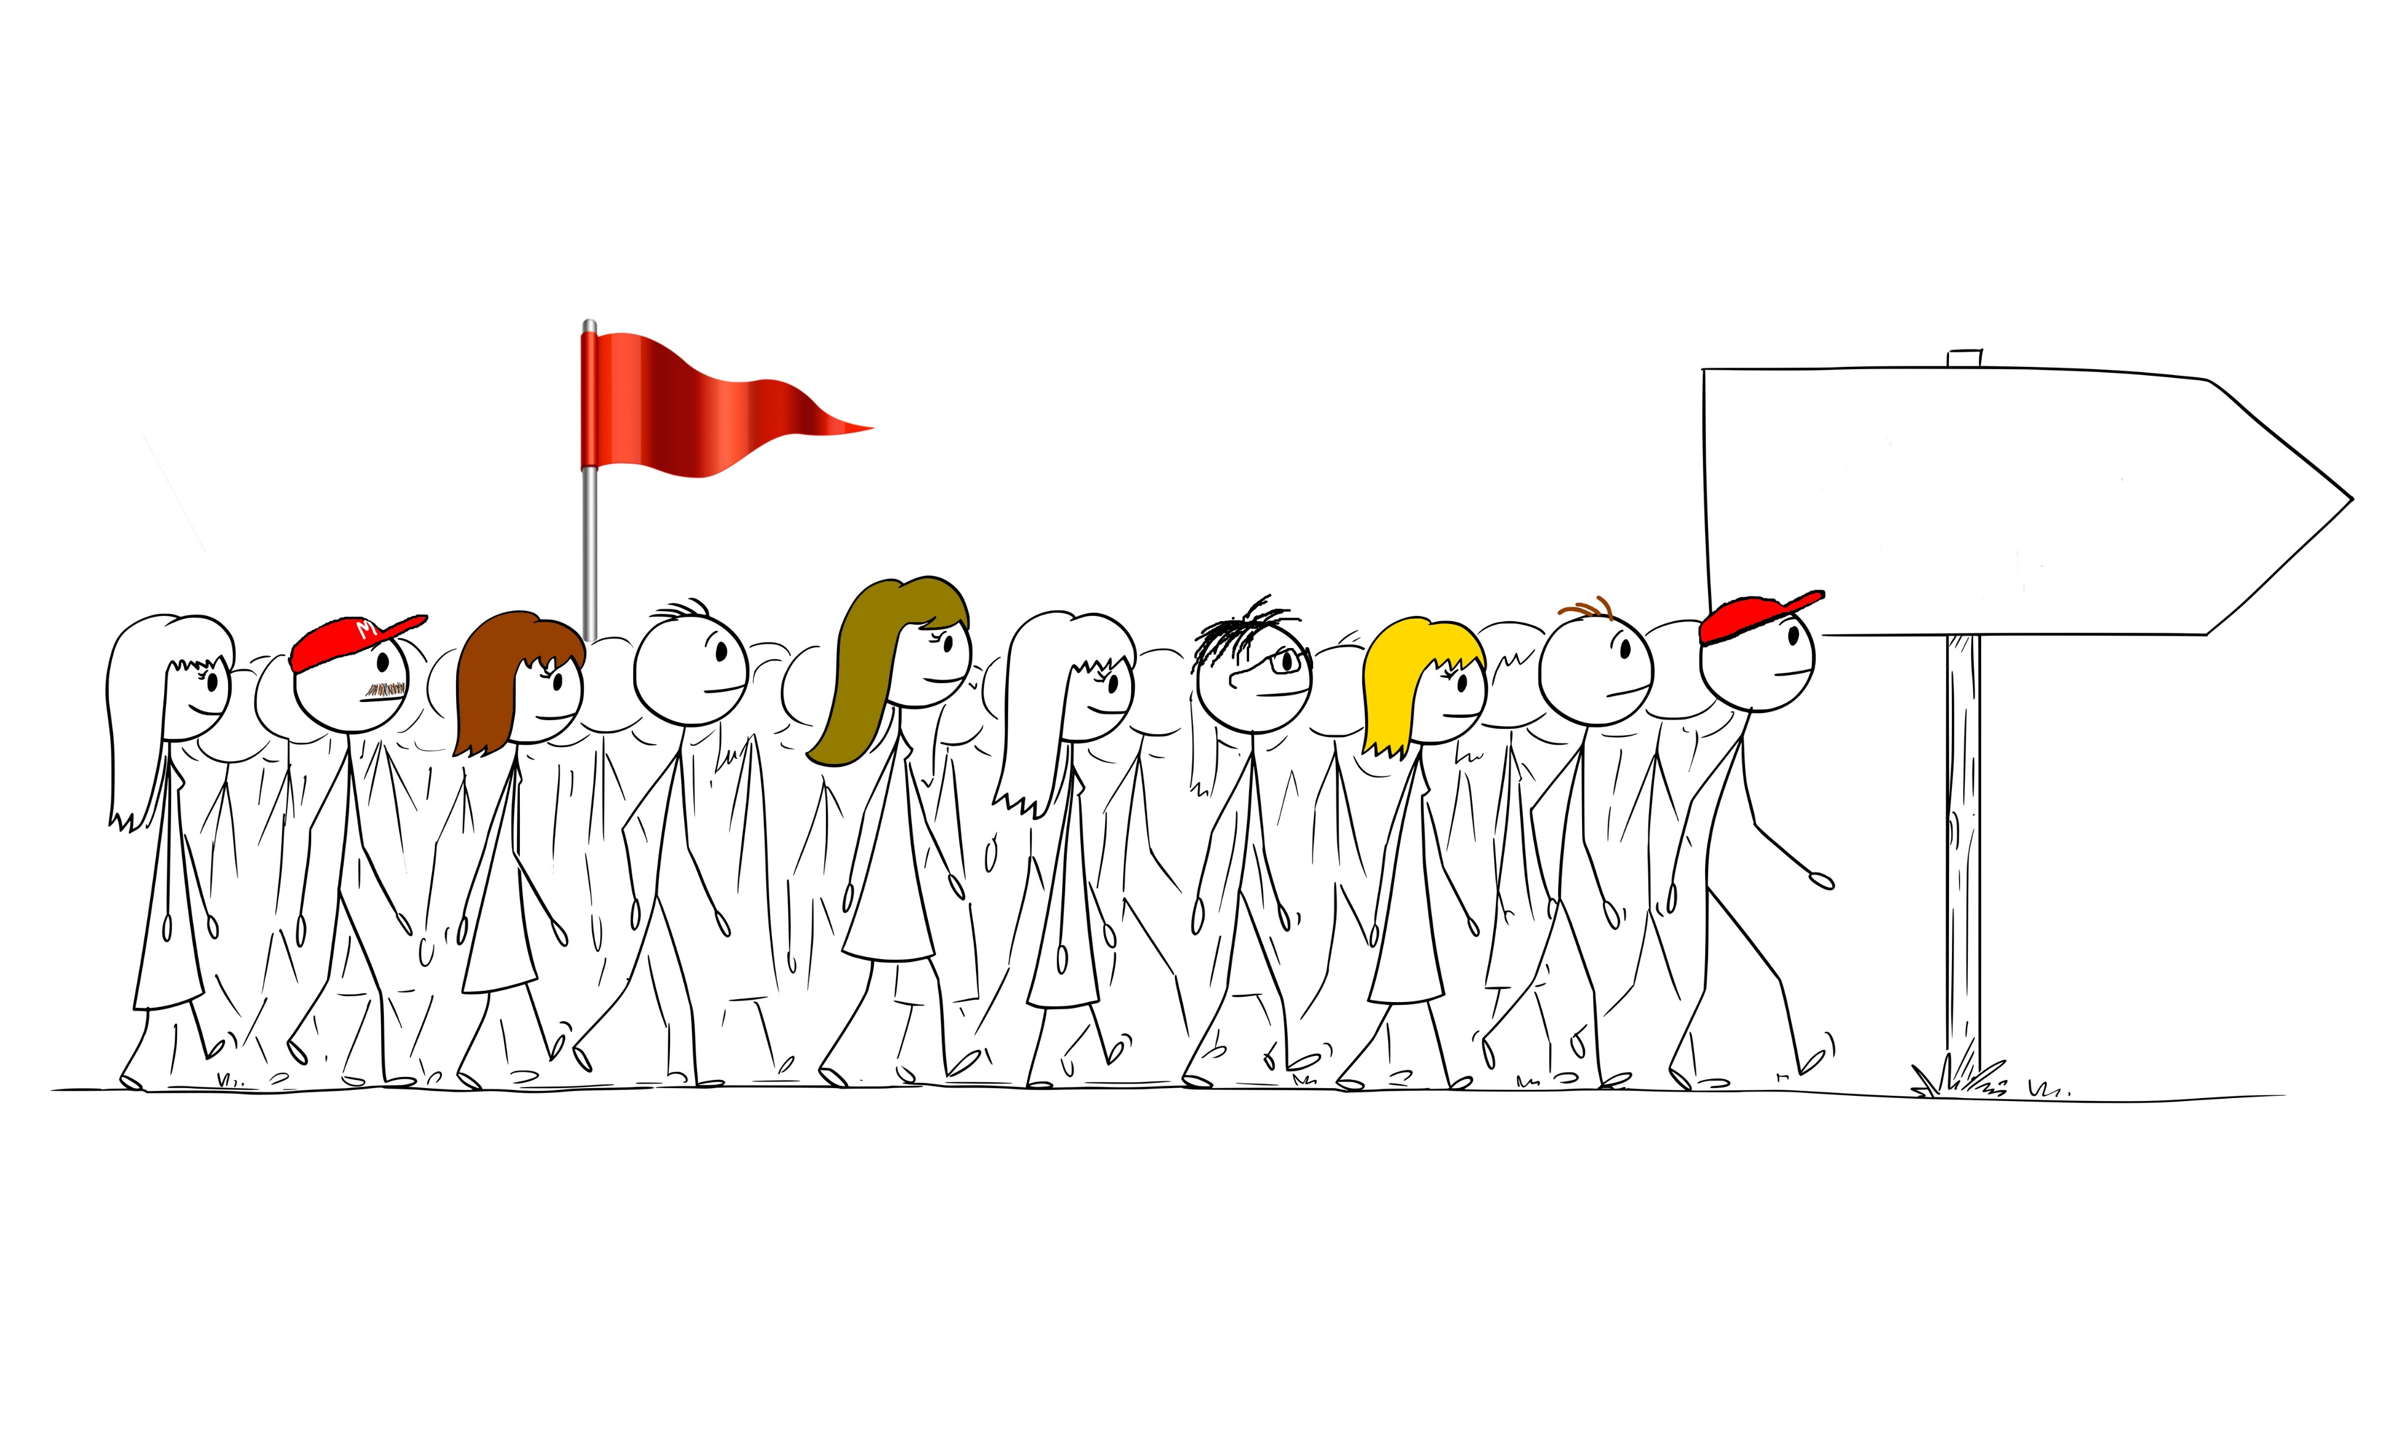

In May, all of the county delegates will travel to Columbia to the state convention and represent you in voting for state party leadership and resolutions.
State ConventionState
Notes:
This is how we change the culture of politics in South Carolina. By bringing “we the people” to participate; electing them to roles that have been stagnant for years and re-energizing the party.

Slide 24

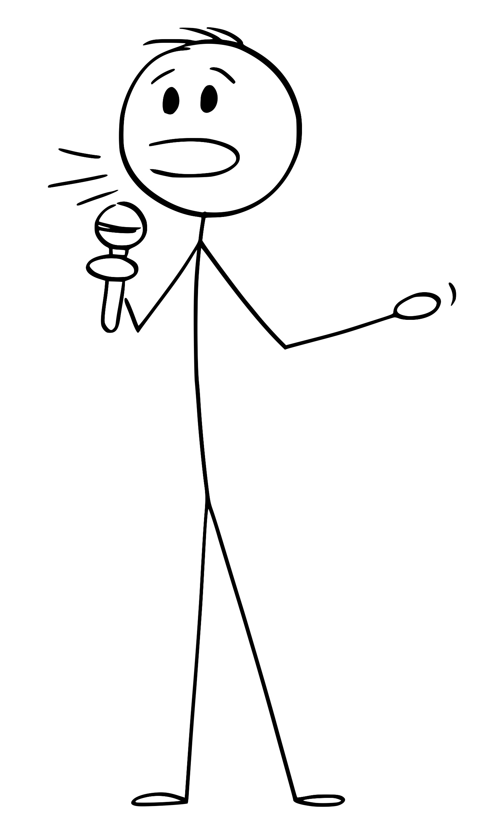
“If we build it, they will come.”
First, “we the people” get involved and build their communities – their precincts.
Next, they send delegations to conventions and raise up grassroots leaders for the future.
The end result? Positive change in our counties and state.
Notes:
Just imagine the political culture change that would result if all 46 counties in South Carolina were filled with vibrant, growing precincts, sending full delegations of grassroots citizens to county and state conventions. These organized precincts would be the classrooms where tomorrow’s officers, leaders, and elected officials would grow their skills and step into the fray, standing for our Constitution, our values, and our platform.

Slide 25
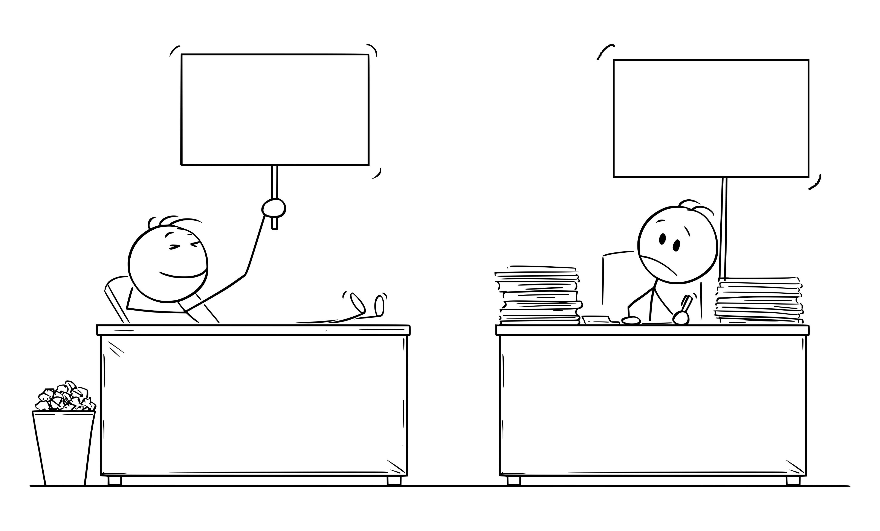
This is NOT a short-term solution. It’s a long game. That’s where all of us come in! This is our 1776 moment, and it’s up to us to keep working locally and make a difference!
I’m finished!
We have a country to save!
Notes:
It IS a long game, not a quick solution. But there will be victories along the way. Across the state, Constitution-loving patriots are changing school boards, county councils, and state legislature seats!

Slide 26

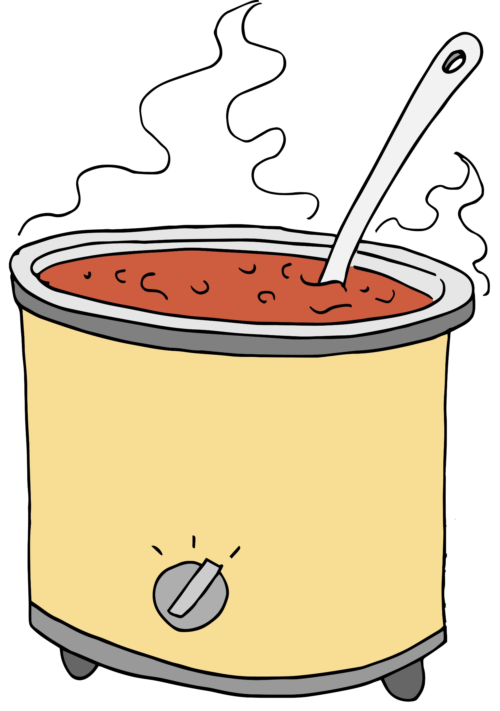
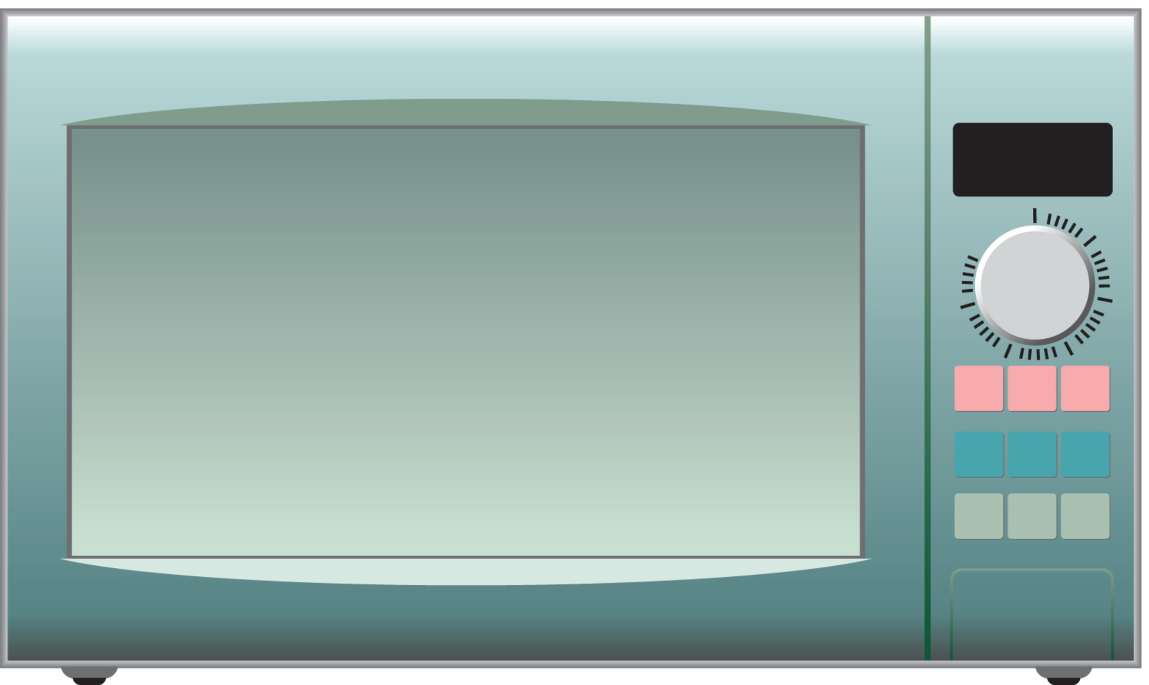
Change is more like a crock pot than a microwave.
But it’s going to be worth it!
Notes:
The hard work that we all put in will be worth it!

Slide 27
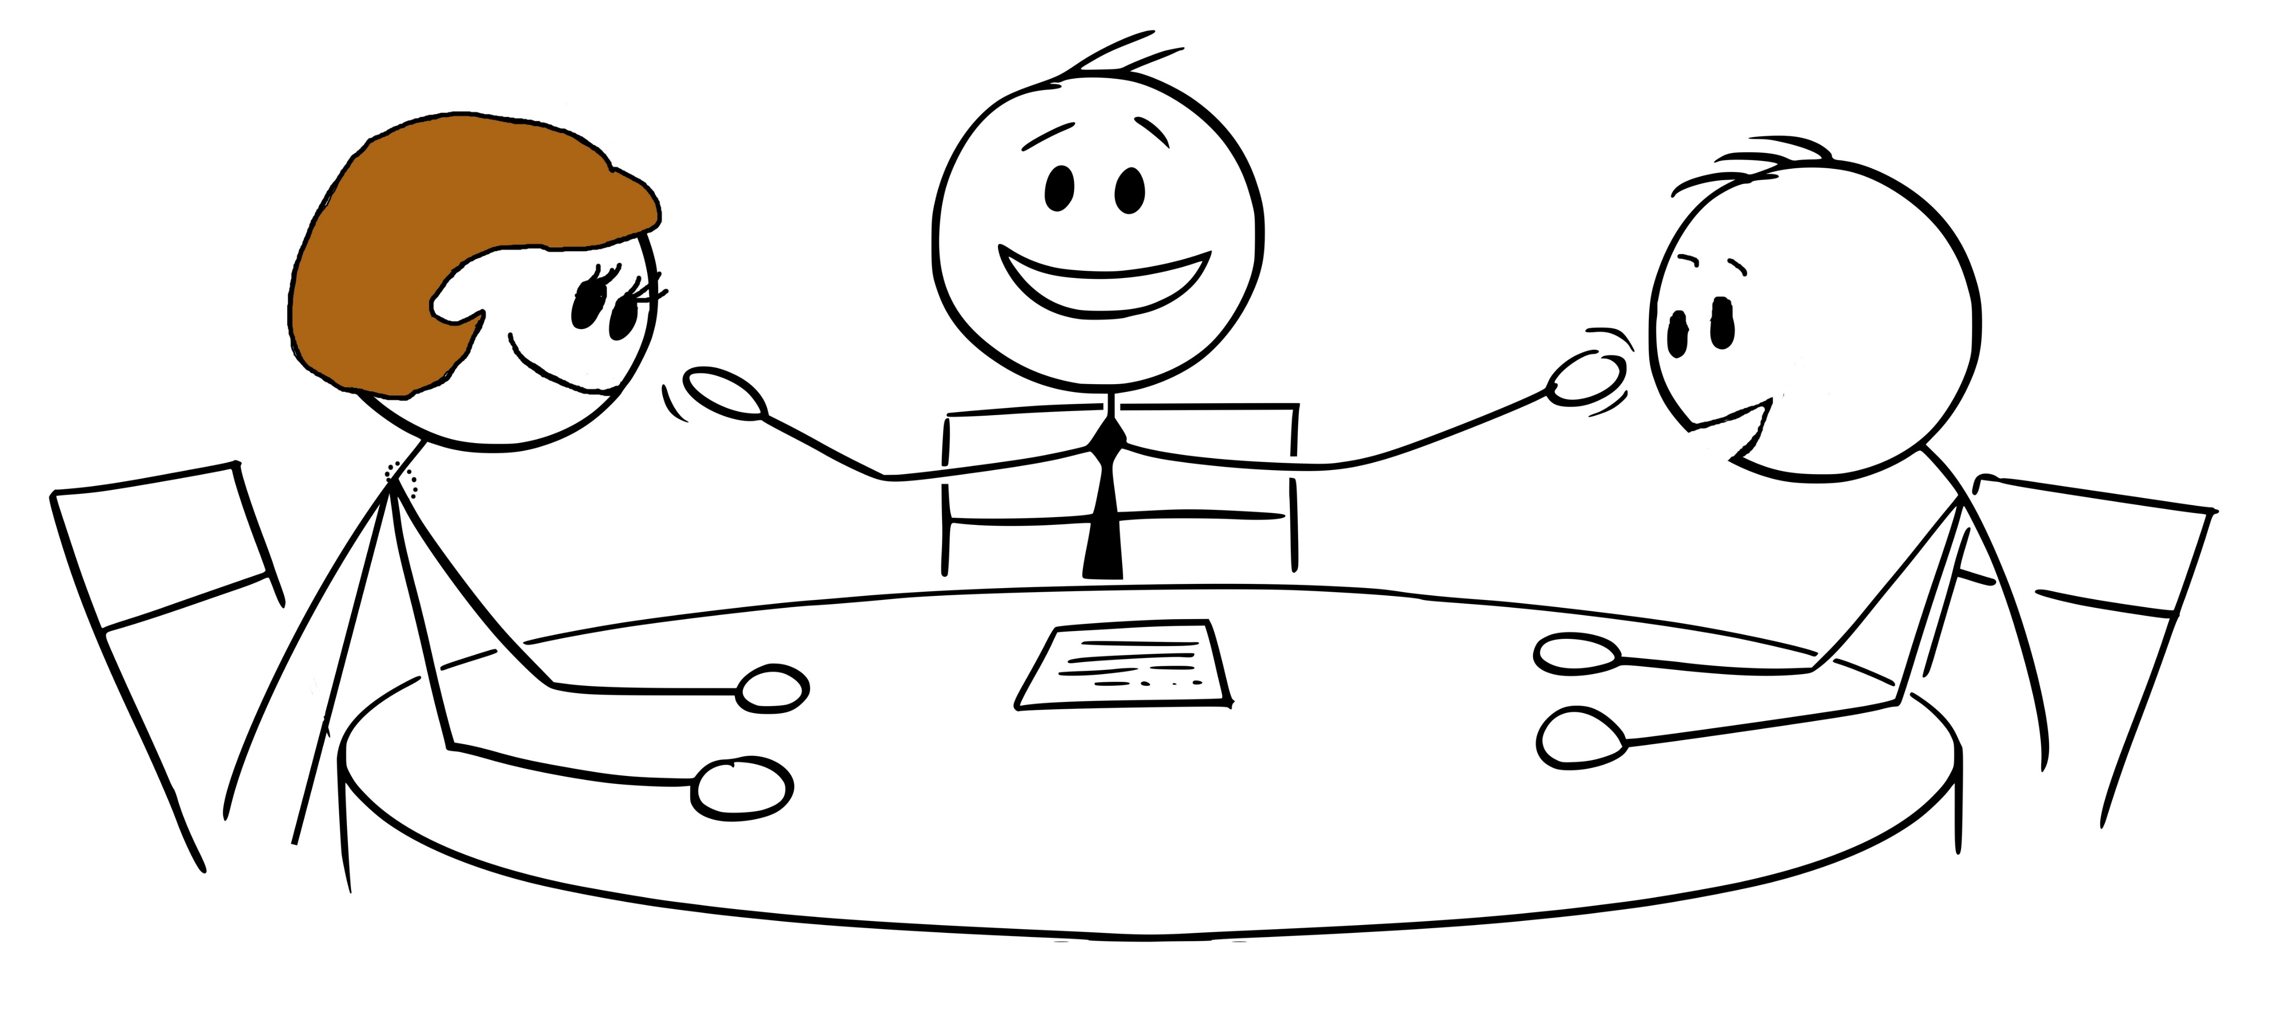
Vibrant, growing precincts can accomplish great things: grow caring communities, work with legislators to change bills, elect candidates who love our Constitution!
Notes:
If you find yourself thinking, “should I get involved?” Or if your neighbor asks you, “can we really make a difference?” The answer is yes! Precincts have effected changes in legislation, in budget provisos, and more. All of this is possible by starting locally and growing!

Slide 28
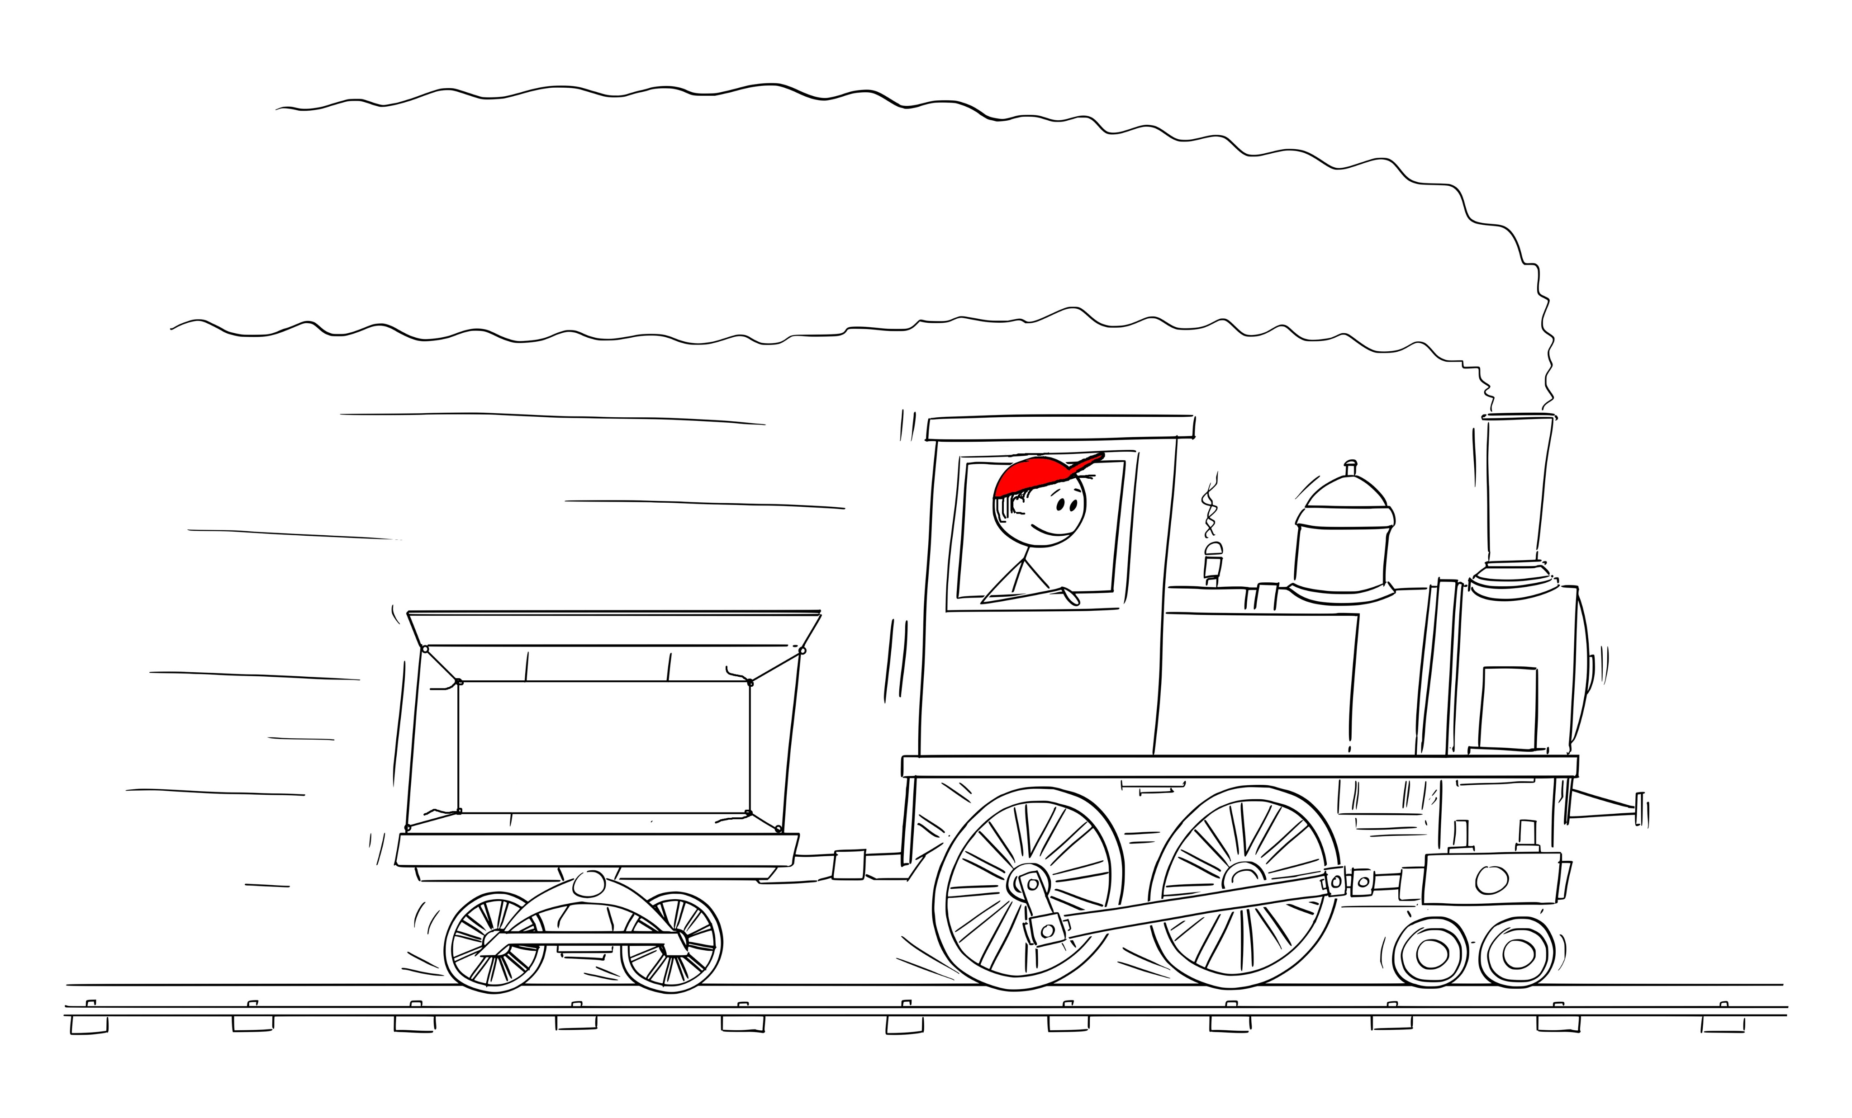
This grassroots movement is gaining momentum; we can’t let it stall out!
We the People
Notes:
Across the state of South Carolina, county councils, school boards, library boards, and planning commissions have new grassroots members.

Slide 29
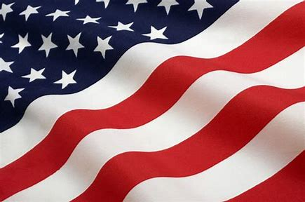

Now you know the nuts and bolts:
Build your precinct
Bring everyone to reorganization in March
Be part of making a difference
Have fun and keep it going!!
Notes:
We can all work together and tell others about this strategy. It’s a plan that has worked before and it can work again! It’s a plan that gets results! Yes, we CAN save our country! Come and join us!

Slide 30
Licensed by CC BY-NC-ND 4.0.
This work is licensed under Creative Commons Attribution-NonCommercial-NoDerivatives 4.0 International. To view a copy of this license, visit https://creativecommons.org/licenses/by-nc-nd/4.0/

