Slide 1

All Politics is Local
Popularized by Tip O’Neill
Notes:
Hi, for those of you who don’t know me, I’m (insert your name here), and I would like to thank all of you for coming tonight. We have a presentation that will give us a bird’s eye view of the role of the precinct, GOP officers and how the GOP is organized and why you should care. Once this presentation completes, you should have an understanding of why precincts are important and why your involvement can make a difference for our county and for our country

Slide 2
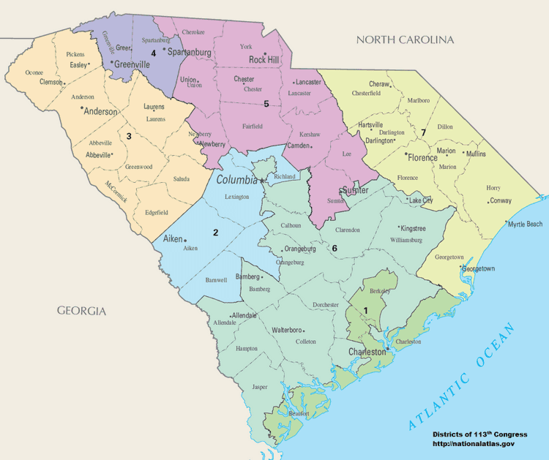
South Carolina – Districts and Counties
Notes:
Title 7 of the SC Code of Laws lays the foundation for how political parties are established and certified, and establishes rules for how the parties are organized. Each party: Democrat, Republican, Constitution, etc. is governed by these statutes.
Title 7, chapter 7 lists each county in the state (there are 46)
Counties and even parts of counties are grouped into into congressional districts – there are 7 of those in South Carolina and each district gets a congressional house representative.
Our district is district X and has X number of counties in it. Our congressional representative is [name of representative]
Counties are also divided into precincts
A precinct is the smallest political geographic division in a state. The area varies in size and is determined by population.

Slide 3
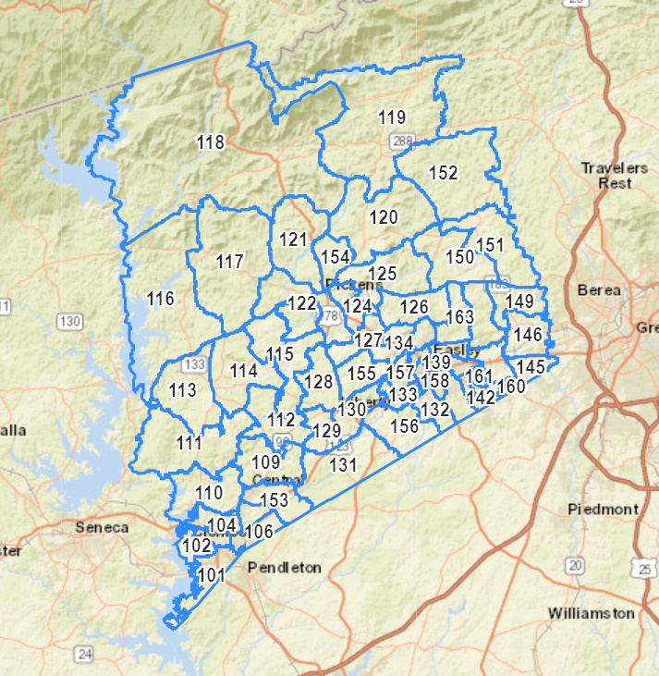
Example: Pickens county has 61 precincts
Notes:
[you should customize your slide for your county and precincts]
Here’s a map of a county (Pickens County) and there are 61 precincts.
You can see from this that Picken’s county population is spread out with more of the population located in the southern portion where the city of Easley is located.
Where there is more population, you will likely see more precincts since the state has indicated precinct size should be no more than 1500 voters.
These 1500 voters will be the people living near you – your friends and your neighbors.
One other important piece of information is that there are organized precincts and there are precincts that are not organized.
An organized precinct is one that is recognized as such at Reorg (which we will discuss shortly) or by the county Executive Committee and usually has at least one elected officer. If there is only on officer in a precinct that person might take on most of the roles in the precinct.
Every organized precinct will have a vote at Reorg and able to elect delegates to the county convention – more on this later.
This “one elected officer” is not in the rules, but is just common sense – if there is no one to represent the precinct officially then it is not organized. (Rule 4 of the South Carolina Republican Party Rules - https://sc.gop/assets/uploads/2022/09/SCGOP-Rules-Updated-2022-Convention.pdf

Slide 4
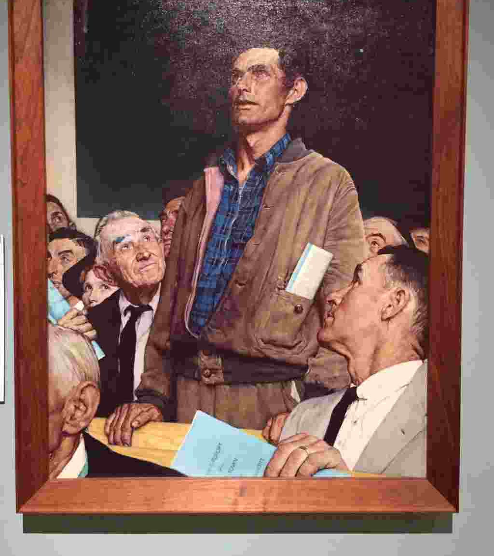
So what’s the big deal about precincts?
Why are they important?
And how do they play into how the overall functioning of the GOP?
Notes:
Very important questions. Precincts are probably the most critical component of the GOP political structure.
Precincts are truly the grassroots foundation and the building blocks of the entire GOP.
It is where you as an individual can really have an impact on your county, state, district and even national GOP.
It is important to understand the structure of precincts because the structure governing a precinct is the same structure governing the County GOP, the District GOP, the state GOP and even the national GOP.
Once you understand one, you will understand them all.
So the next question is how precinct officers are elected and how do all these parts of the GOP work together?

Slide 5

Precinct – GOP Officers
The EC or Executive Committeeman: Votes in county GOP meetings – this is the highest level position. If there are resolutions or decisions to be made for the GOP at the county level, this is the person who should listen to the needs of his/her precinct and vote accordingly.
NOTE: there is no EC role at the district level
The President/Chairman: Organizes precinct meetings, recruits new members and will take the place of the EC in the event that he/she can’t attend the county GOP meetings
Secretary: will generally take notes of the meetings and help organize meetings as required by the President.
Treasurer: will manage the finances of the precinct.
Delegates: these are precinct members who are elected to go to the county convention to represent their precinct and its interests.
Notes:
Precincts have officers that are elected to a 2 year term. The EC and President will generally attend all county GOP meetings (only the EC has the vote and the president will only vote in the absence of the EC).
The EC (or president/chairman) is the person who represents his/her precinct – what they want and need – at the GOP meetings to make sure those needs are being heard and acted upon.
These same officer roles also exist at the county, district, state and national levels – the functions are similar but just with a greater scope/jurisdiction.
The only difference is at the precinct level there is a President, but at the county or higher levels, the role is called the Chairman.
Detailed brochures on each of these roles is available here: https://www.screpublicanassembly.org/

Slide 6
GOP Organization
Precinct
Officer led, Recruitment, Community activities, candidate forums, monthly meetings, decisions for precinct members
County GOP
Officer led, Recruitment, Community activities, candidate forums, monthly/quarterly meetings, decisions for county GOP
State GOP
Officer led, Quarterly EC meetings, well funded, full time staff, donor relations, participation in national RNC, candidate support, decisions for the state GOP
Notes:
These officers are elected at something called Reorg or Reorganization. We will go into that in a minute.
The GOP leaders that are elected at Reorg will serve for two years and run the party in their respective jurisdictions for that time. Exceptions however are district and national GOP officers – these are elected to 4 year terms.
Precincts focus on direct community involvement, issues that are of interest to their neighbors and they work on recruitment – it is essential to build their numbers so they can have a greater influence on what happens at the county and state levels.
County GOP runs the party at the county level – holds the monthly/quarterly EC meetings – where the ECs are gathered to bring their precincts’ concerns to the GOP leadership, vote on how money is spent, events, resolutions.
The ECs really are the ones that are running the county GOP although the County Chairman is the organizer – like the president at the precinct level.
The chairman is supposed to be listening to their ECs and implementing and responding to their needs – most decisions are supposed to be made with a vote of the ECs.
If the ECs are not happy with the performance of their chairman, they can censure him/her although that rarely happens but did just happen recently in one county.
Districts are a little different but also can have meetings, bring their counties together to have greater impact in the counties as well as in the state. In the past these have been sort of do nothing positions- officers are elected and never heard from again for four years, but that is changing.
State GOP is run similarly to the county and the same ideas apply. This is really where all the funding comes from. The SC GOP interacts with donors and provides financial support (or not) to the districts and counties. Again the ECs are the ones that are really supposed to be running things, with the chairman acting in response to their directives.
So from the precinct level to state and even national, it is a numbers game – whoever has the numbers will win. Whoever has the most ECs with their vote will win.
This is very critical because it is really at the state level where key decisions are made about how millions of dollars of party money is spent, how donors are managed, where GOP support for candidates will be given – this is why it is so critical for the precincts to grow and recruit likeminded individuals – so that through the precincts, the grassroots can impact the GOP not only locally but also at the state level.
The next item to be discussed is how are these officers elected?
At something called Reorg

Slide 7
Reorg in a Nutshell
Reorg
Local Precinct
March
Elect Precinct GOP Officers & County delegates
Held every 2 years
County Convention
County
April
Elect County GOP Officers & State/District delegates - Held every 2 years
County Convention
District
April
Elect District GOP Officers & National delegates
Held every 4 years
State Convention
State
May
Elect State & National GOP Officers & National delegates - held every 2 years
National Convention
National
Nominate President & Vice President
Held every 4 years
Notes:
How are precinct officers elected? They are elected at something called Reorg.
What is Reorg?
The SC Code establishes the schedule, and each political party is required to hold reorganization meetings every two years. This is when the people in all of the different precincts will meet and elect precinct officers and county convention delegates.
The next reorg is in March of 2025.
Some counties hold their Reorg meeting in a centralized location where all the precincts gather together to vote on their officers and delegates. Some other counties follow a more distributed model and hold their Reorg in the each of the precincts and then report back to the county on elections and decisions.
Either way, Reorg is mandated by South Carolina law and it is really important for as many people as possible to participate – if you have built community at your precinct and increased your numbers, you will know who is likeminded, and who is interested in serving as leaders. – having the numbers will allow you to vote your preferred officers into leadership and these people will carry your requirements to the county, state, district and even national level.
In the past, in many counties across South Carolina, there are precincts where only one or two people have come to reorg in the past. Many of these folks have been attending for decades. They participate at reorg to elect their friends and then don’t come back for two years! That’s very frustrating for “we the people” who really want to be involved . . .and want positive change.
If the same people keep getting voted in and then do nothing for two years, then nothing will ever change.
It is at the precincts that we can start to change this.
Once the precincts elect their officers and delegates, then the delegates will go to the County convention.
County convention is essentially reorg for the County GOP.
At the county convention, these delegates will elect officers who will run the county GOP - note again the officer roles mirror those elected at the precinct level but they just have a higher level of authority – at the county level. EC, President (starting at the county level the President role is now called Chairman), Secretary and Treasurer. There are also Vice-Chair roles.
The elected county EC will attend the quarterly state GOP meetings and has the ability to vote. The county chair should also attend the meetings in Columbia but can’t vote.
State Delegates are also elected at the county convention.
District conventions are held every four years, coinciding with the presidential elections. Districts also nominate national delegates and alternates and also elect their officers at that convention. These officers and delegates have four year terms. District chairman have no vote, but can attend the state quarterly GOP meetings. Remember there is no EC at the district level.
In May, there will be a state convention and all elected state delegates are expected to attend.
The state convention is essentially Reorg for the state.
This is where the SC state chairman and executive committeemen/women (as well as other officers) are elected. Every four years, national delegates will also be elected by the state to go to the national convention where the president/vice president are official nominated.
So from the precinct level and Reorg, it goes to the county convention and then to the state convention
And again, it is a numbers game – whoever has the most delegates or
This is very critical because it is really at the state level where key decisions are made about how millions of dollars of party money is spent, how donors are managed, where GOP support for candidates will be given – this is why it is so critical for the precincts to grow and recruit likeminded individuals – so that through the precincts, the grassroots can impact the GOP at the state level.

Slide 8

Precinct Powerhouses!
Notes:
So you can start to see how the precincts can be powerhouses: The more counties whose precincts are active, growing, and prepared for Reorg 2025, the more voice those members will have in the direction of their communities, their county, and their state.
First you elect your precinct officers and delegates. Then at the county convention, your delegates elect officers who will represent you not only at the county level of the GOP, but also at the state level. And it all starts with the precinct.
This is the key takeaway from the slides so far – the more that we get involved, and the more that we grow our communities (precincts) the more our views and values will be represented and heard.
This is the key to grassroots success!
County conventions re-vitalized by grassroots folks will elect officers who reflect the ideal that the grassroots should inform/instruct the state party leadership.
When these officers attend the state executive committee meetings it’s the best way to ensure that the citizens of your precinct, and your county are represented.

Slide 9

There’s an empty chair waiting for you!
Notes:
For a long time, there’s been an empty chair at the table. Our “1776 moment” is now – if you want to be a part of the decisions in your county and state, that empty chair is waiting for you. Step up and claim that chair – empower others around you by your example. We the People can make a difference!

